Slide 1
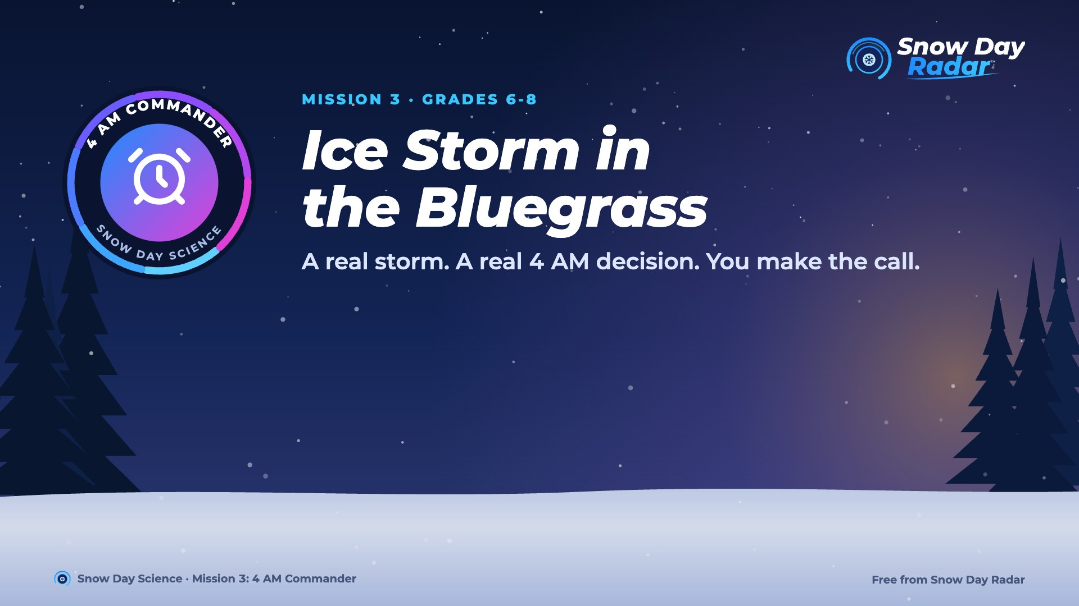
Notes:
Today you're the superintendent of Fayette County Public Schools in Lexington, Kentucky, on a real storm morning: January 6, 2025.

Slide 2
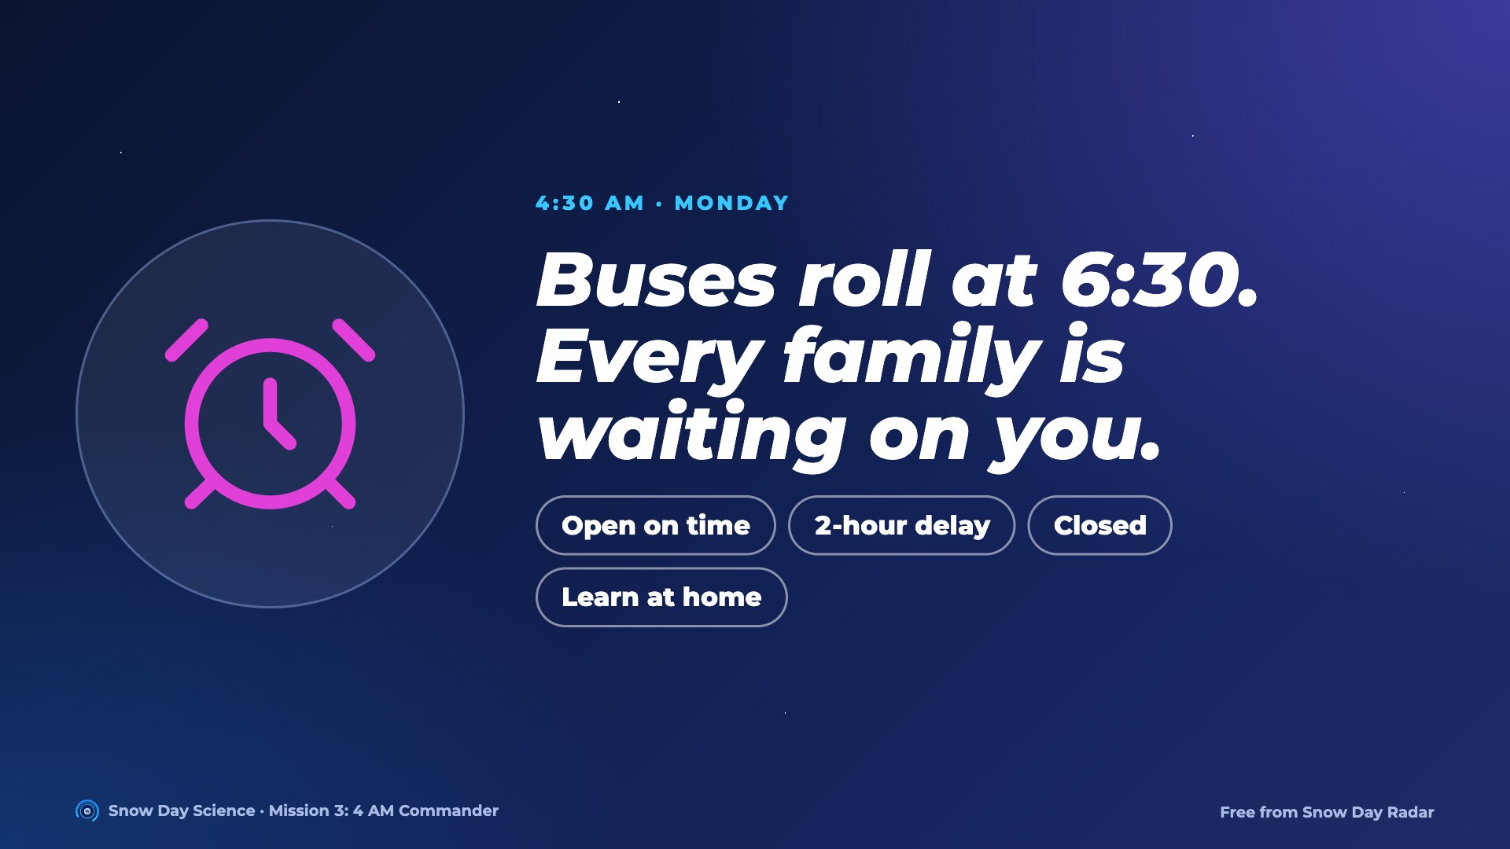
Notes:
Many superintendents decide in this window, after crews drive the bus routes before dawn; when a storm is obvious, some decide the night before. The call has to go out before buses leave.

Slide 3
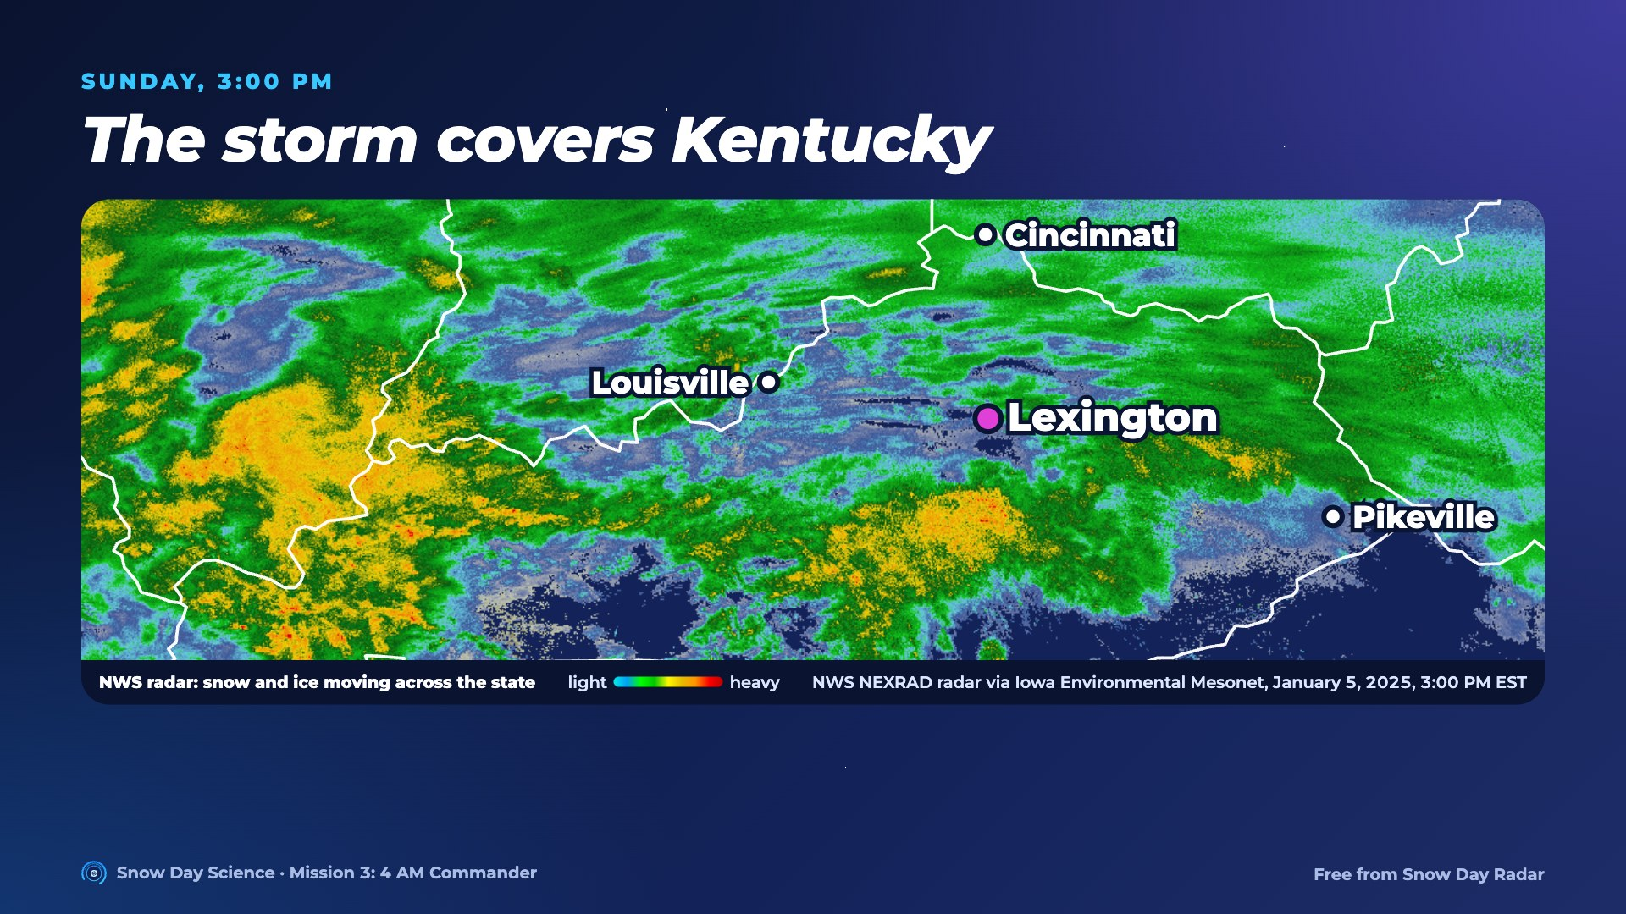
Notes:
Real NEXRAD radar from Sunday afternoon. The whole state is covered. At Lexington, snow is about to change to freezing rain.

Slide 4
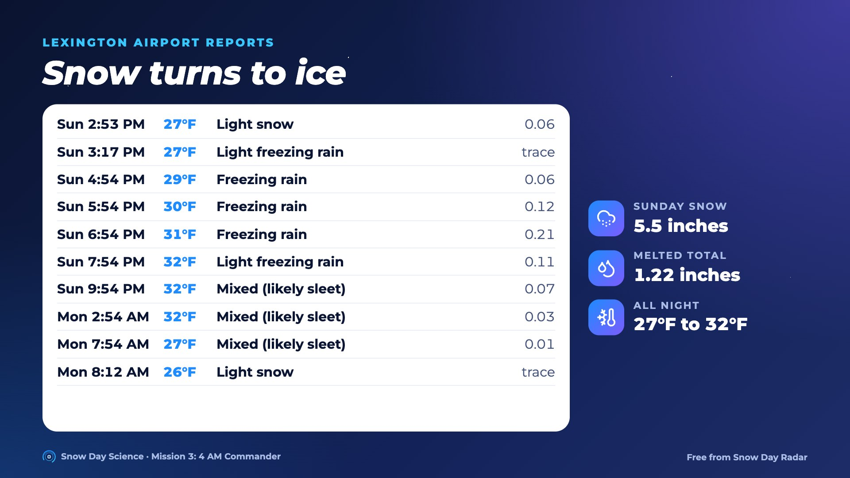
Notes:
Snow turned to freezing rain around 3 PM, then a mix the sensor couldn't name (most likely sleet) overnight. From 4:54 to 7:54 PM: 0.06 + 0.12 + 0.21 + 0.11 = 0.50 inches of freezing rain. Lab 3 explains why.

Slide 5
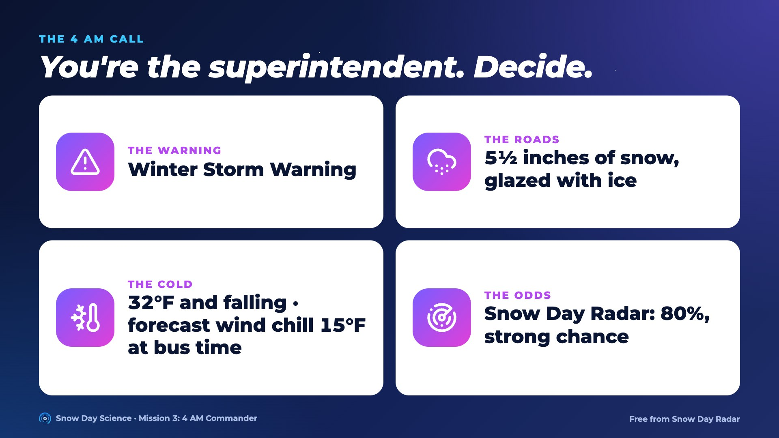
Notes:
Groups decide and back it up with three facts and who it affects: families, bus drivers, students who rely on school meals. Vote, then reveal.

Slide 6
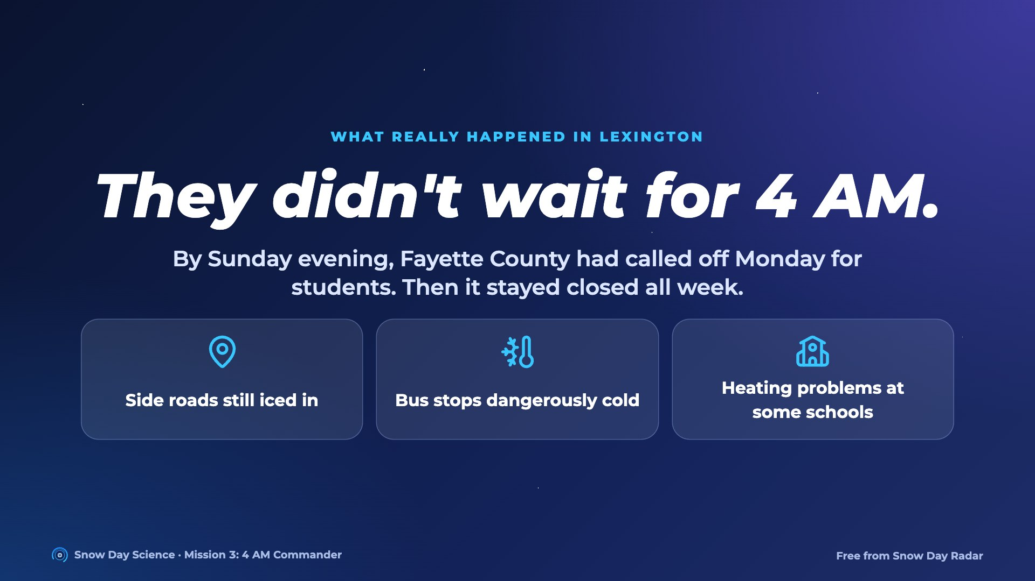
Notes:
Fayette County Public Schools announced Sunday evening that Monday would be a staff-only day, so students stayed home (Kentucky counts it as a weather day). It then closed Tuesday through Friday: side roads were still inaccessible, early-morning cold was dangerous at bus stops and several buildings had heating problems. Learning from home wasn't possible because many students' Chromebooks were still at school after winter break. Discuss: when a storm is this clear, why decide the night before? Snow Day Radar had said 80% on Sunday evening: a strong chance, not a promise.

Slide 7
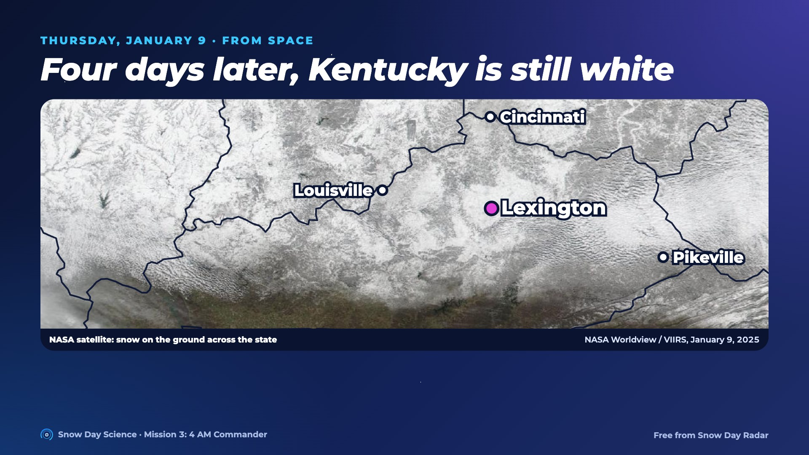
Notes:
Real NASA VIIRS picture. Dark lines are rivers and forests showing through: that's snow on the ground, not clouds.

Slide 8
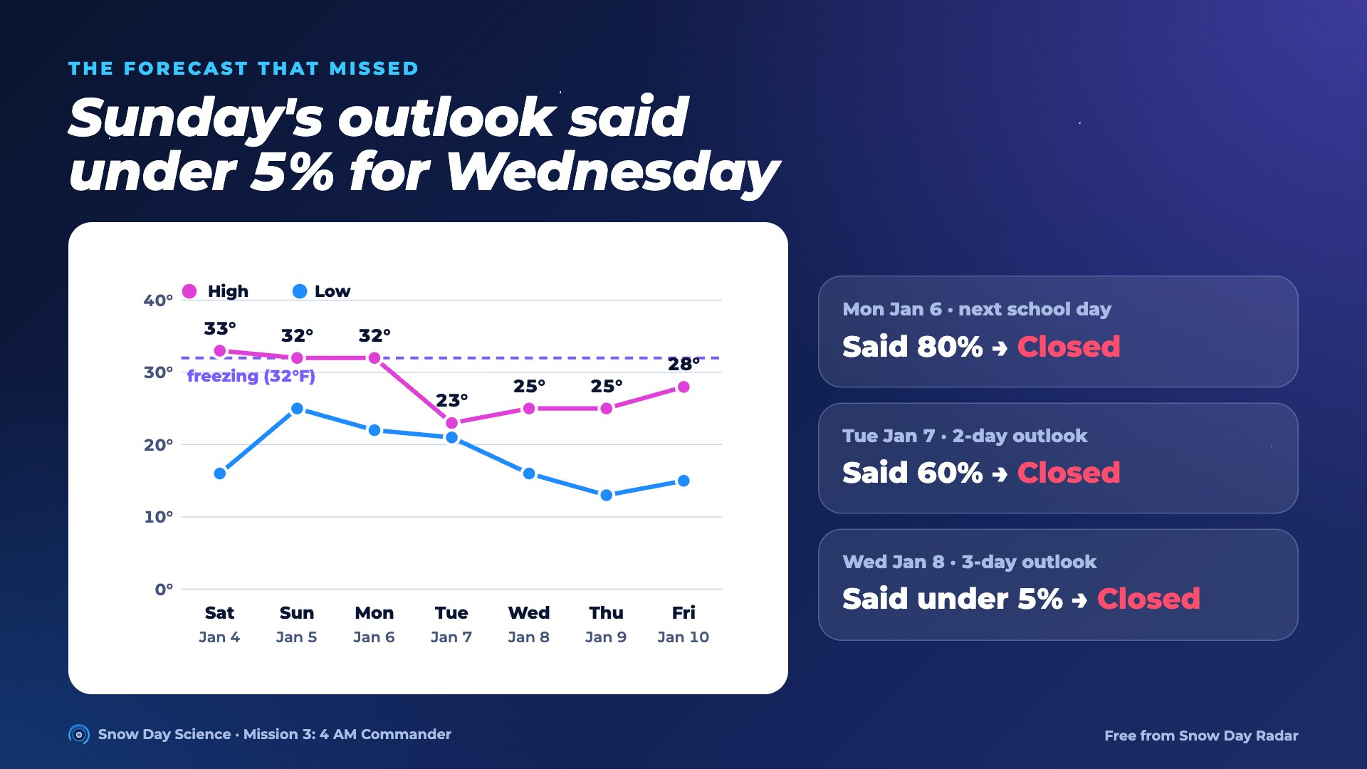
Notes:
Highs stayed at or below freezing all week, so nothing melted, and more light snow fell Wednesday. A 3-day outlook focused on new snow missed the ice and snow already on the roads.

Slide 9
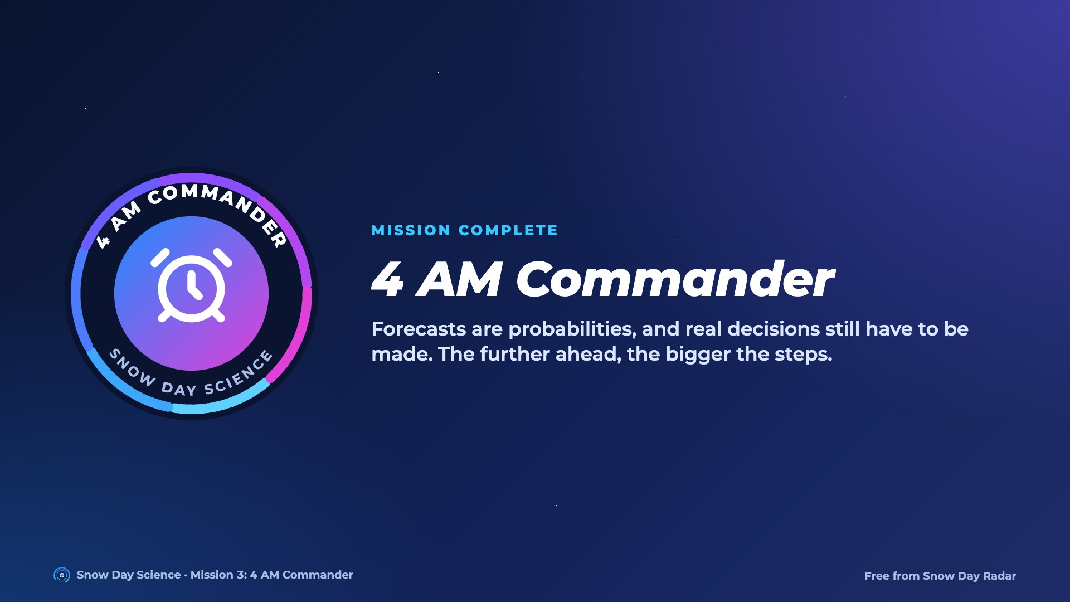
Notes:
Hand out the 4 AM Commander badge. Ask: what should a forecast watch after a big storm? Snow already on the ground and how cold the next days will be.

