Slide 1
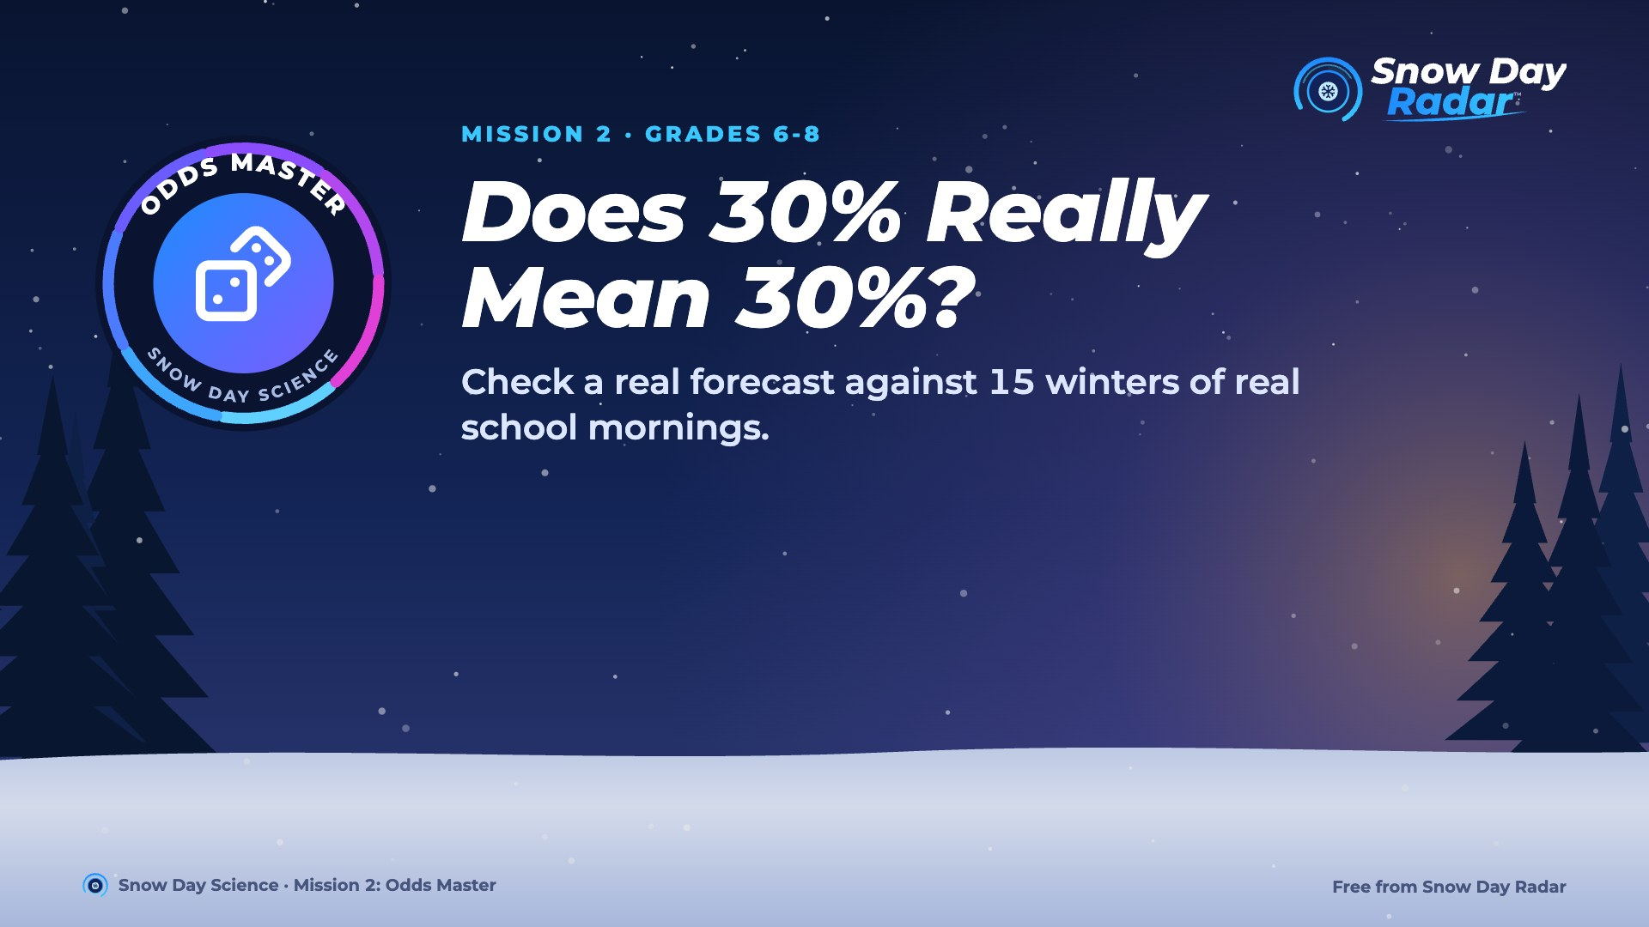
Notes:
Today we find out what a probability really promises, and whether Snow Day Radar keeps its word.

Slide 2
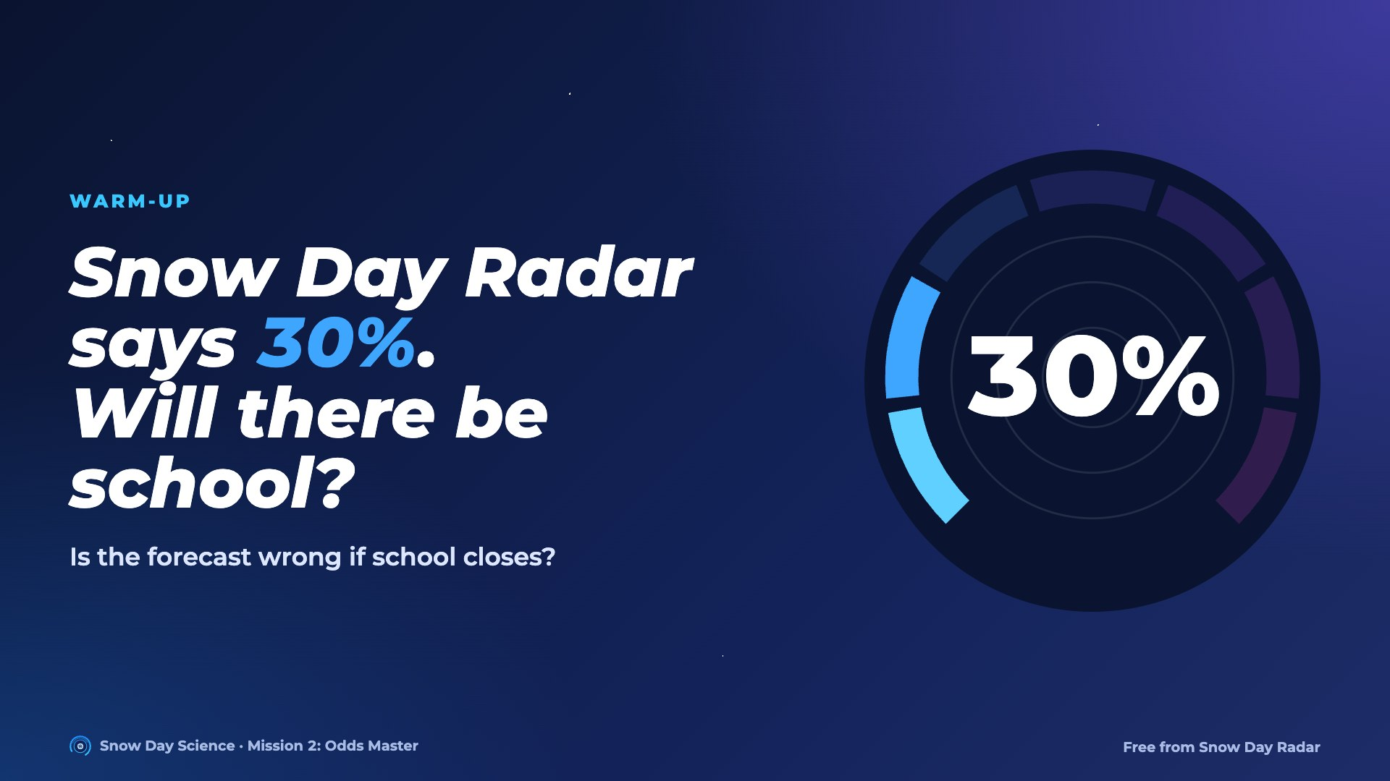
Notes:
Most students will say 'yes, school's on'. Ask: if school closes, was the forecast wrong? Push toward: 30% means it happens about 3 times in 10 nights like this.

Slide 3
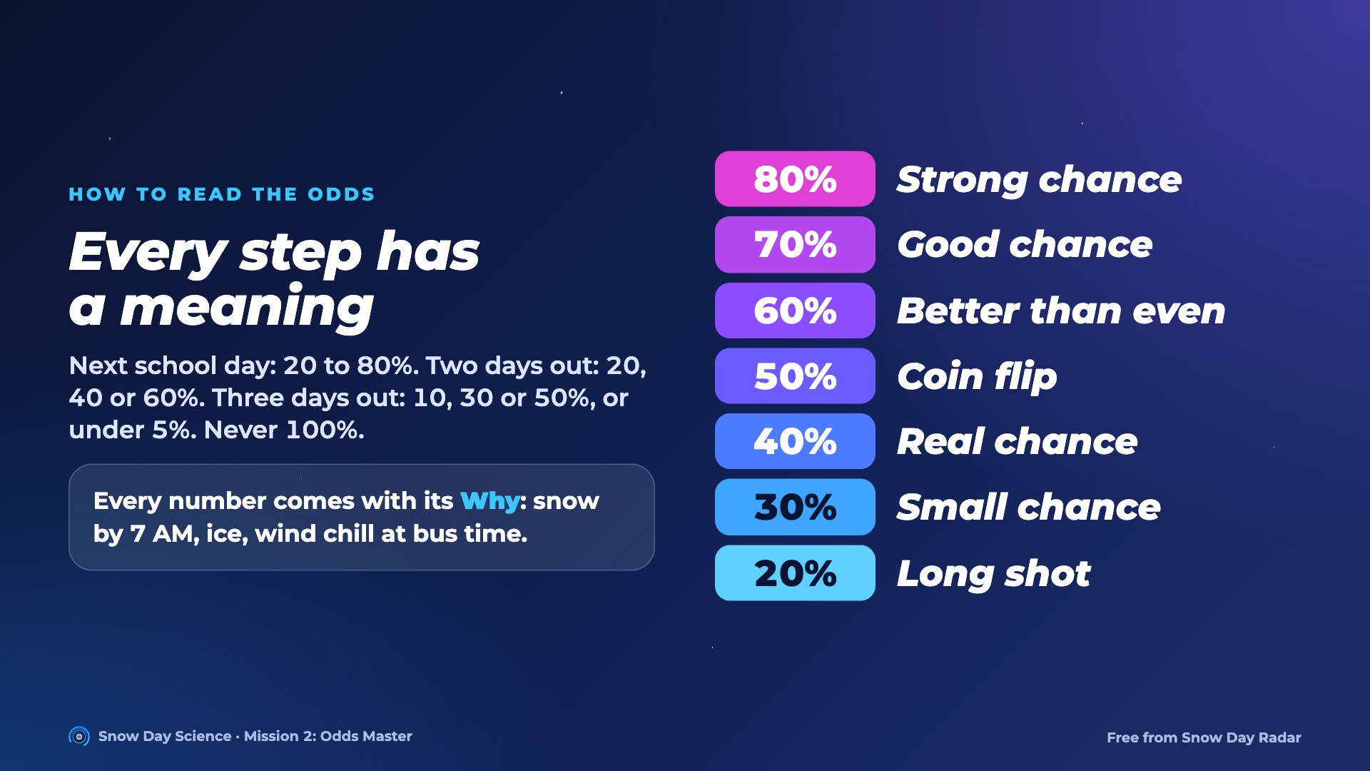
Notes:
Further ahead means less certain, so the steps get bigger. Never 100%: weather can surprise anyone.

Slide 4
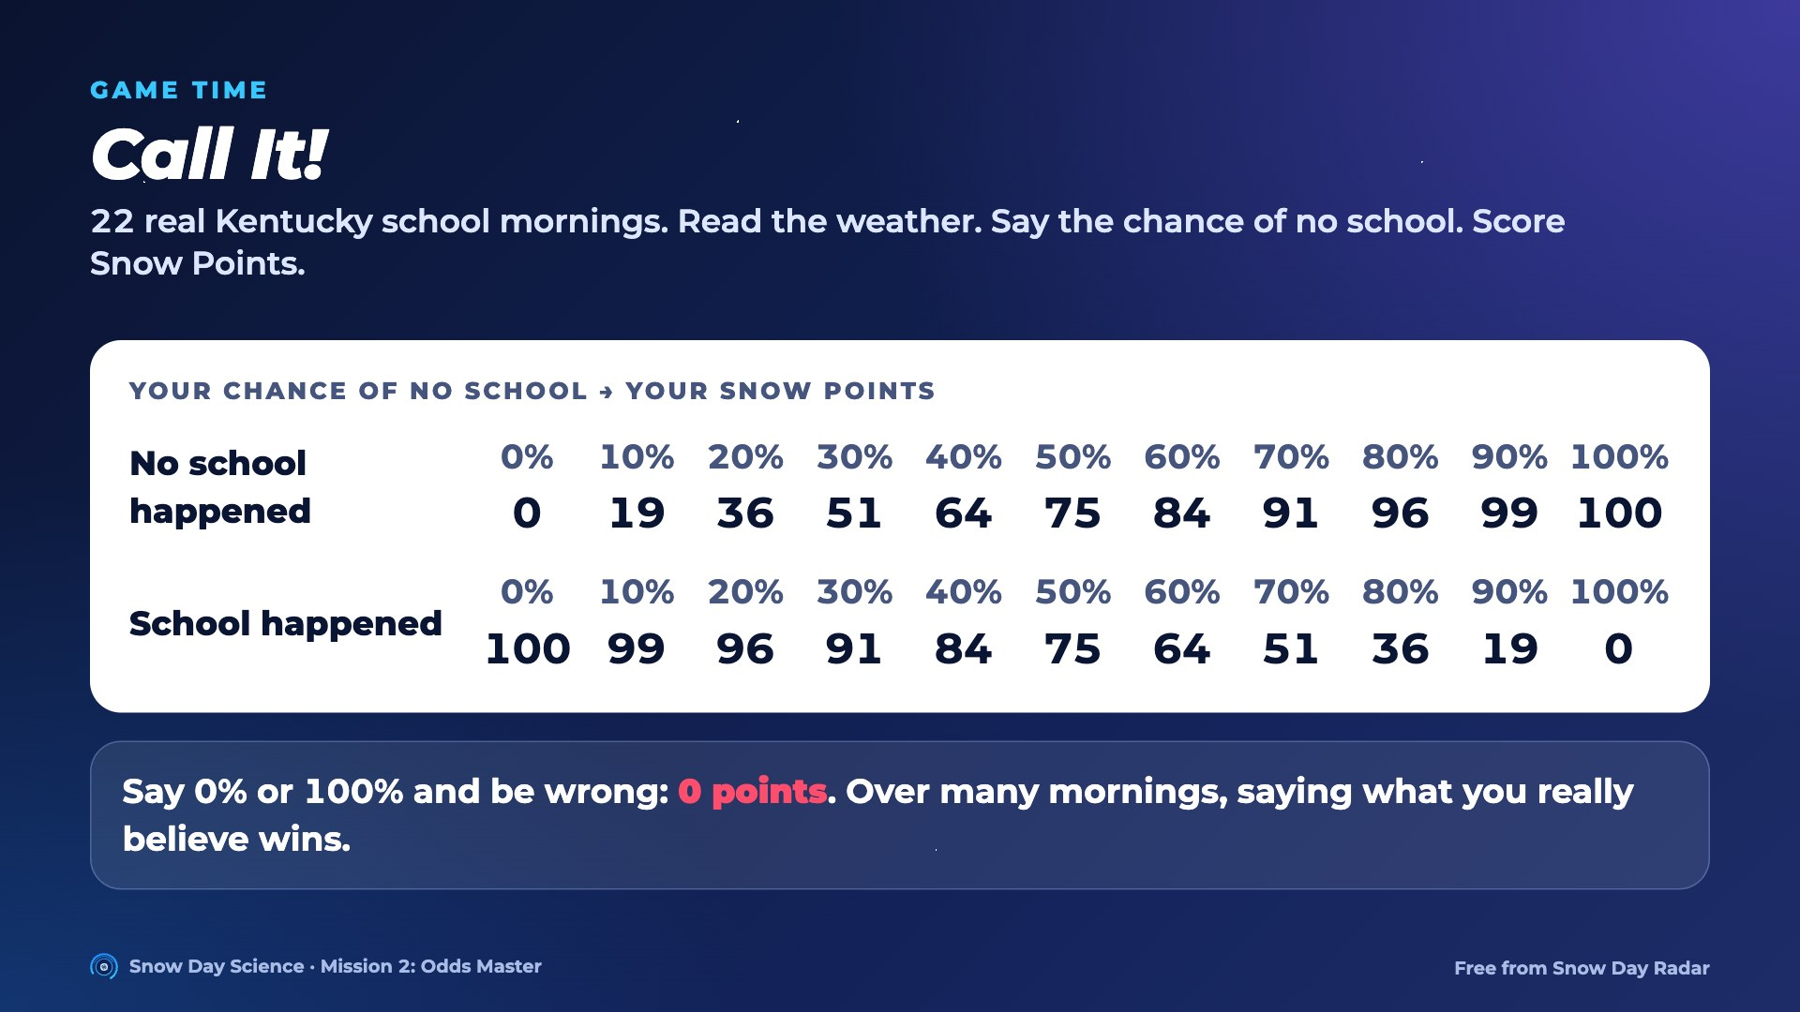
Notes:
Switch to the Call It! deck for ten rounds. Students write a chance of no school from 0 to 100% on the game sheet, then score Snow Points from this table. It's the Brier score real forecasters are graded on, times 100. Honest chances beat bold guesses over many rounds.

Slide 5
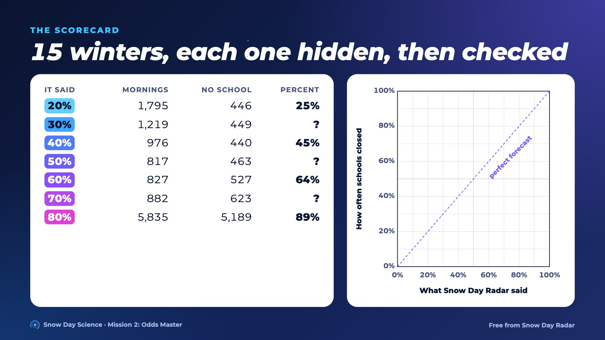
Notes:
Snow Day Radar never saw each winter before it forecast it. Students compute the three ? rows, then plot every row on the grid.

Slide 6
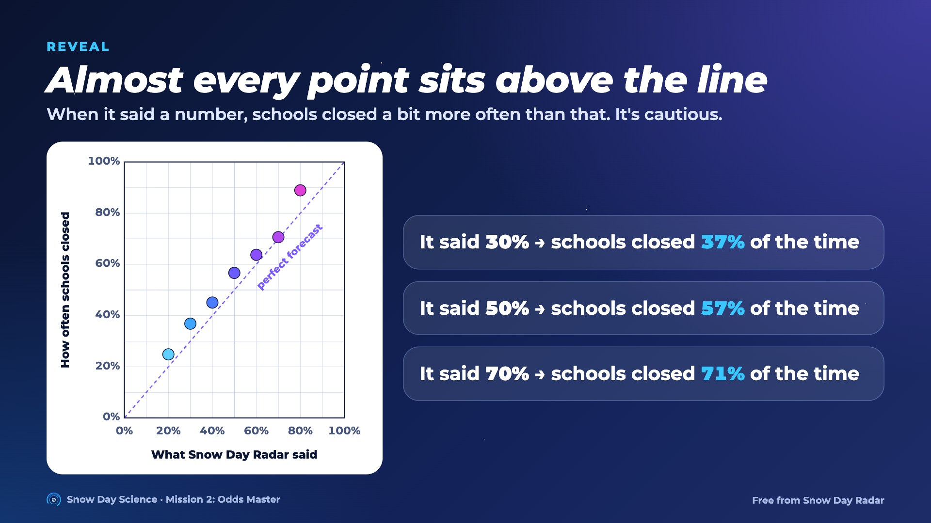
Notes:
30%: 449 of 1,219 = 0.368, about 37%. 50%: 463 of 817 = 0.567. 70%: 623 of 882 = 0.706. Points above the dashed line mean schools closed more often than the odds said. Good news for kids.

Slide 7
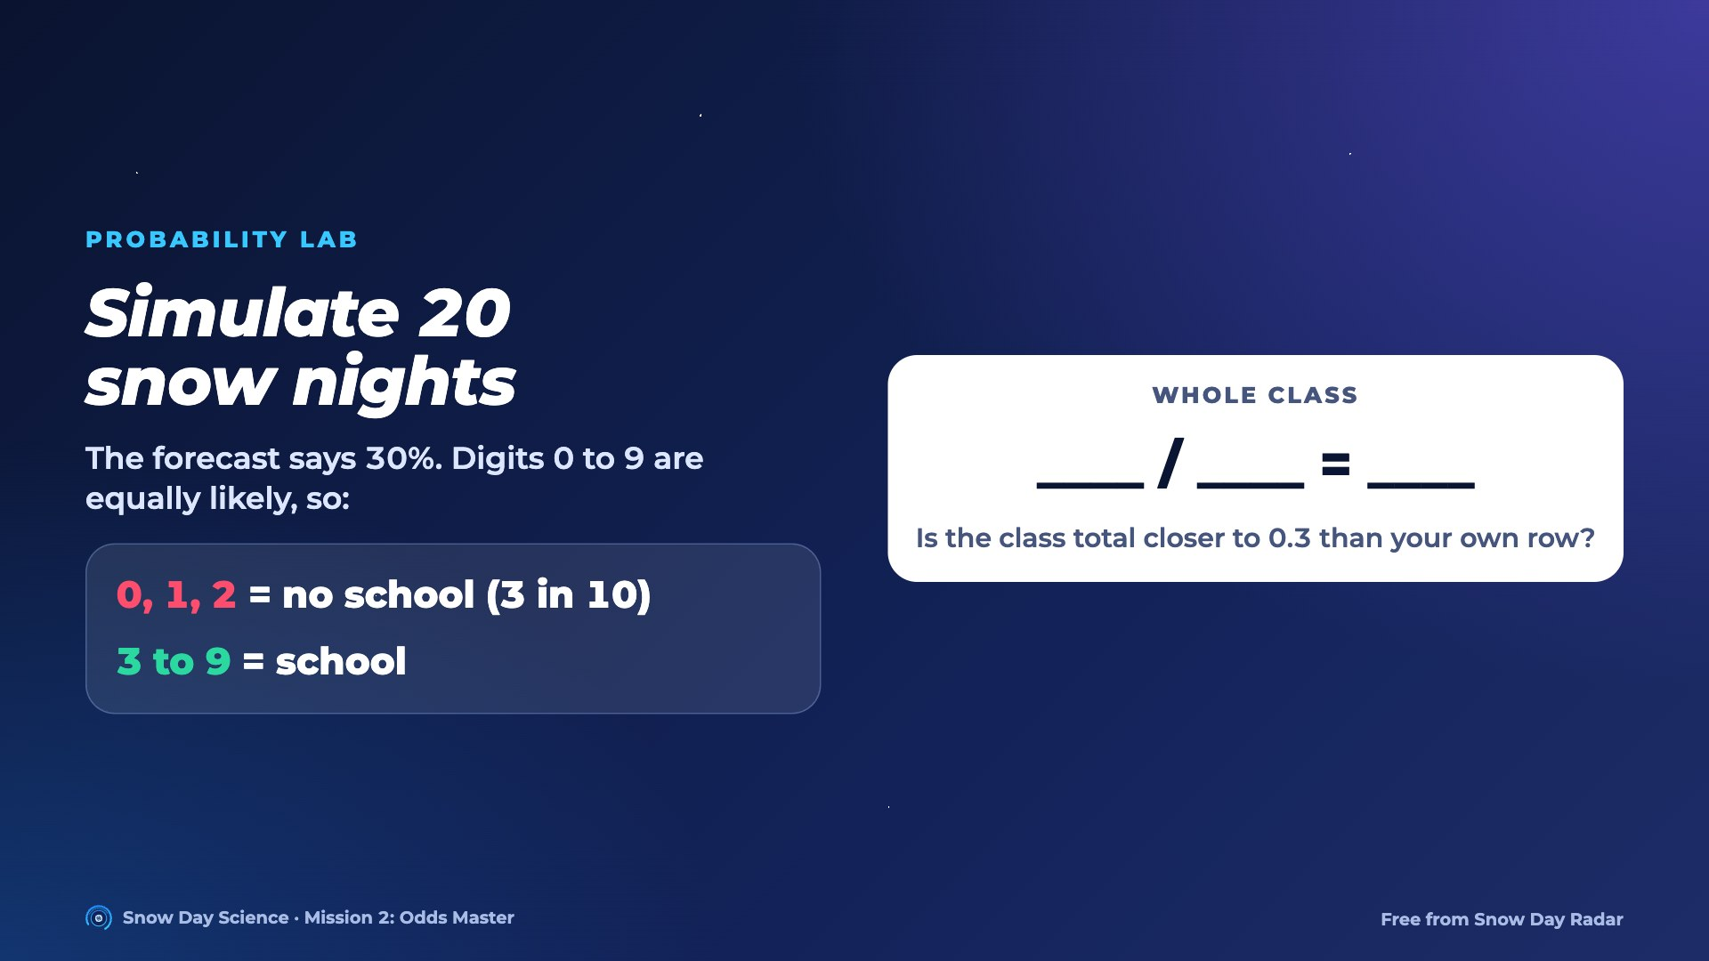
Notes:
Each student tallies one row. Pool the class total on the board. The whole table has 59 no-school nights out of 200: 0.295. Big idea: one night is luck; many nights show the probability.

Slide 8
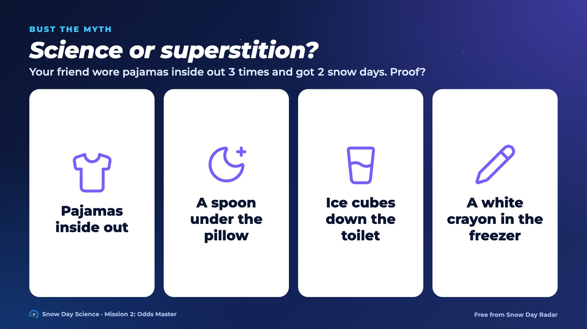
Notes:
Not proof: 3 nights is too few, there's no comparison group, and the snow was coming anyway. What really changes the odds: snow by 7 AM, ice, wind chill at bus time, warnings, and how often your district closes.

Slide 9
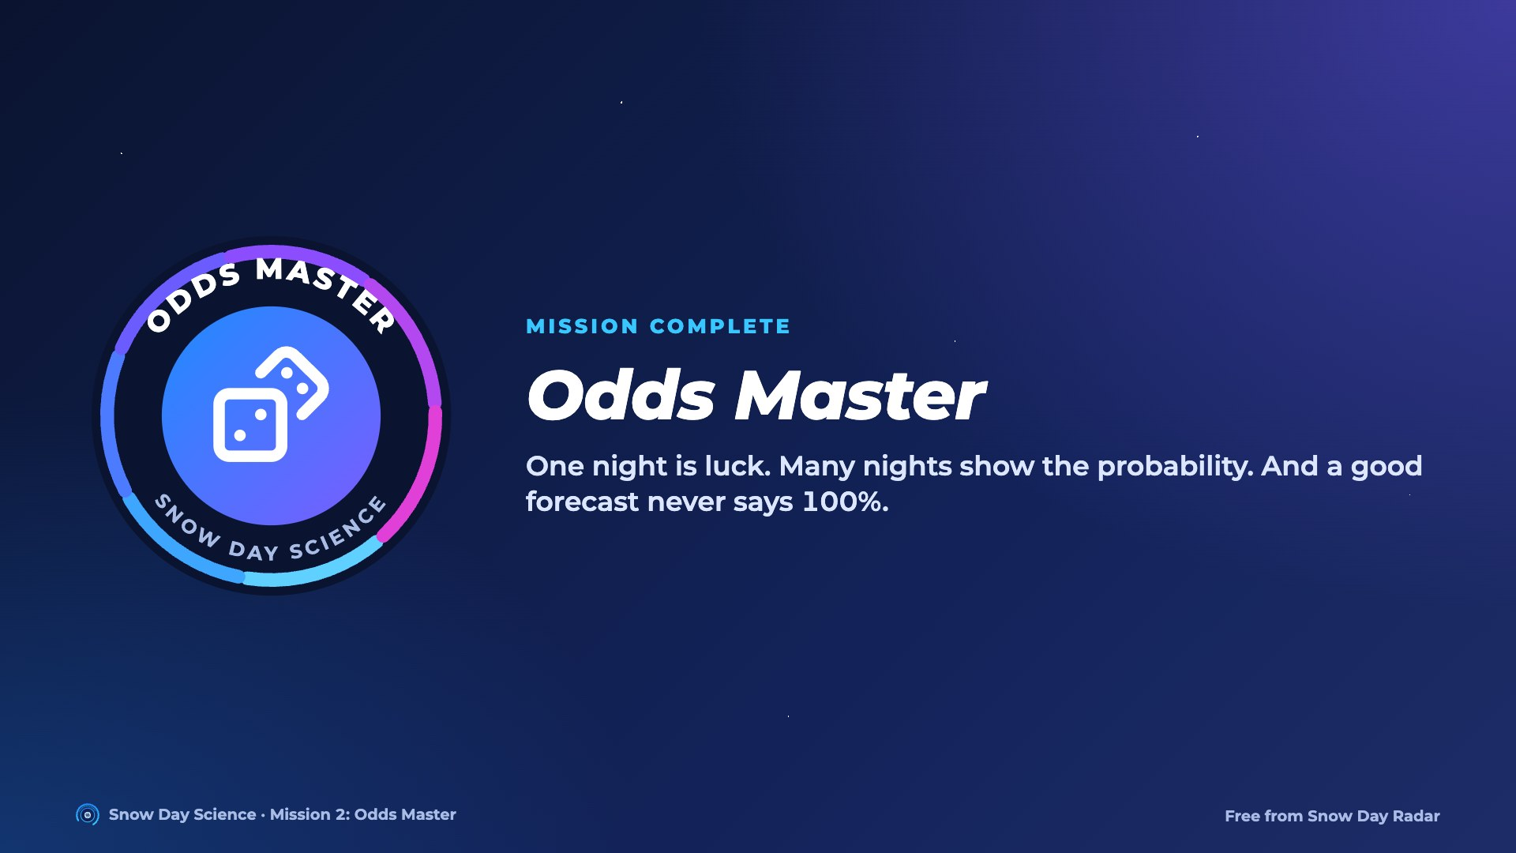
Notes:
Hand out the Odds Master badge. Optional homework: Bust the Myth, designing a fair test.

