Slide 1

Notes:
Welcome, detectives. Today we solve a real weather mystery with real data. By the end you'll earn the Snow Detective badge.

Slide 2

Notes:
Take a quick hands-up vote. Ask one student from each side to explain. Keep the answers on the board: we'll come back to them at the end.

Slide 3

Notes:
A real moment: on January 28, 2014, about 2.6 inches of snow fell on Atlanta. Traffic froze, thousands of drivers left their cars and some kids spent the night at school (NASA Earth Observatory). Buffalo gets 2 inches or more about 15 times a winter. Ask: what could explain it? Collect guesses, then look at the evidence.

Slide 4
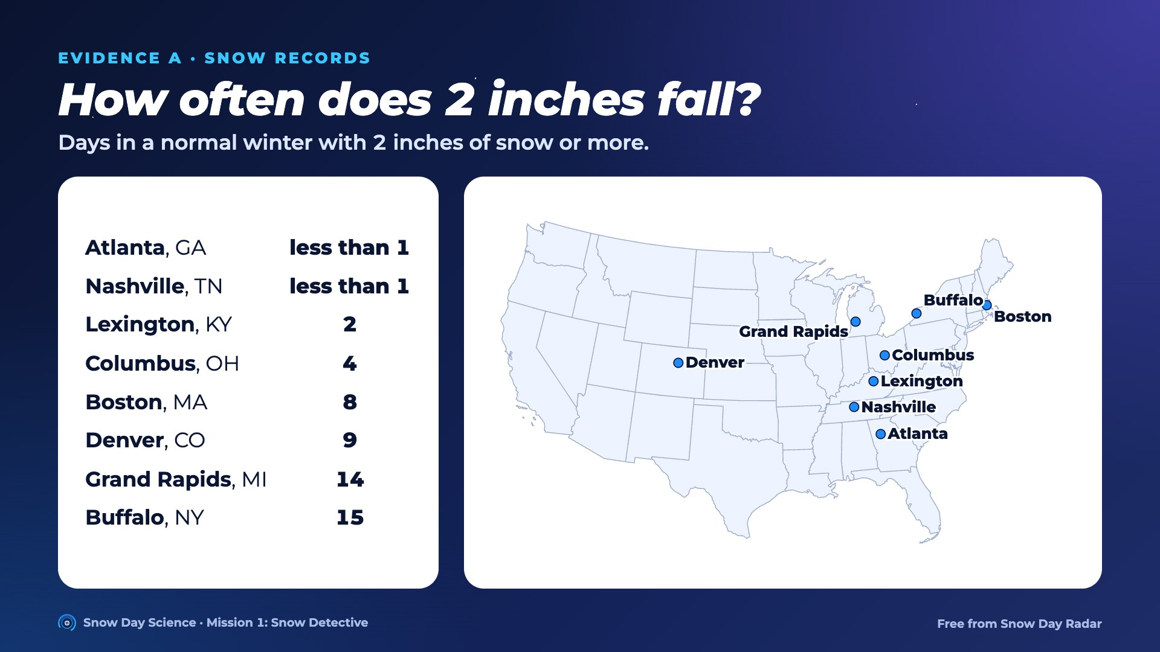
Notes:
Find each city on the map. Before showing the numbers, ask which cities students think get 2 inches most often. Then students graph the table on Case file A.

Slide 5
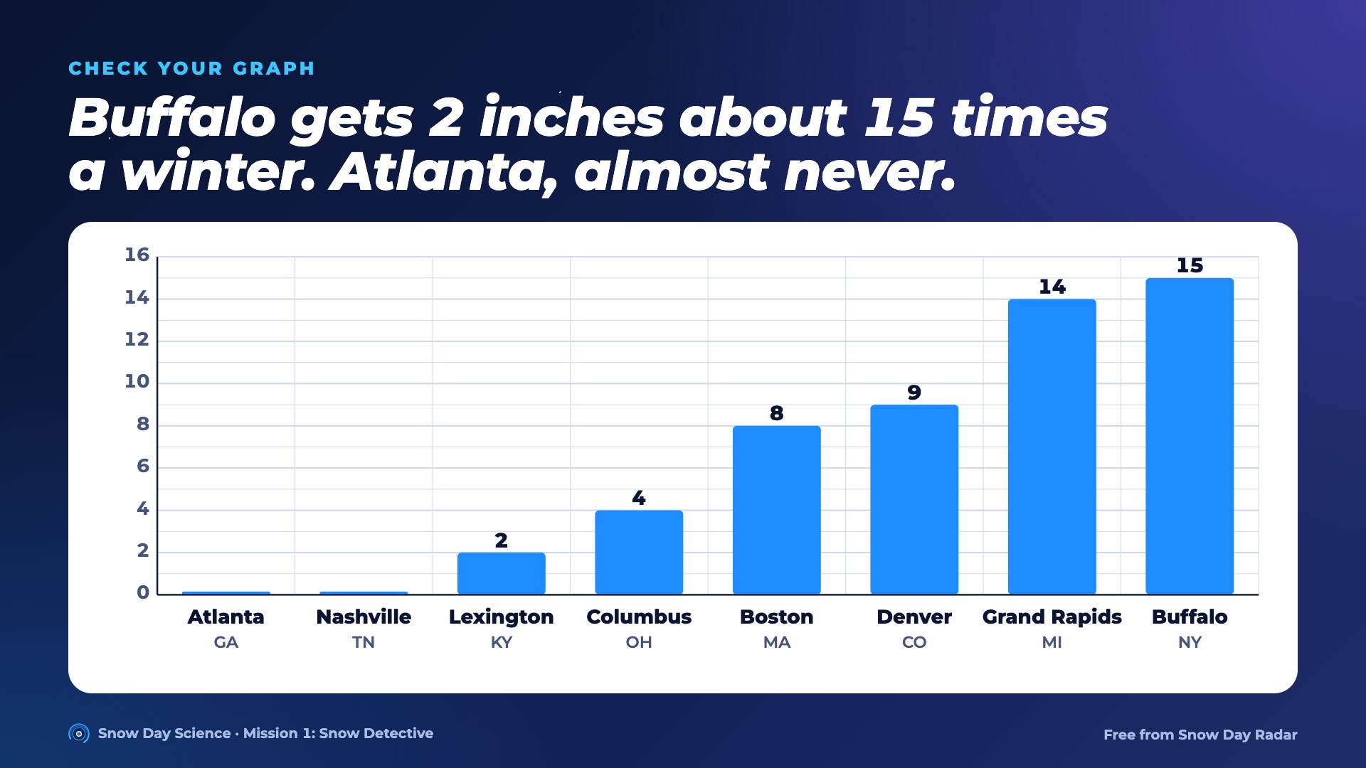
Notes:
Reveal after students finish their graphs. Key idea: where snow is common, towns are ready for it: plows, salt, snow tires, practice. Where it's rare, 2 inches is a big deal.

Slide 6
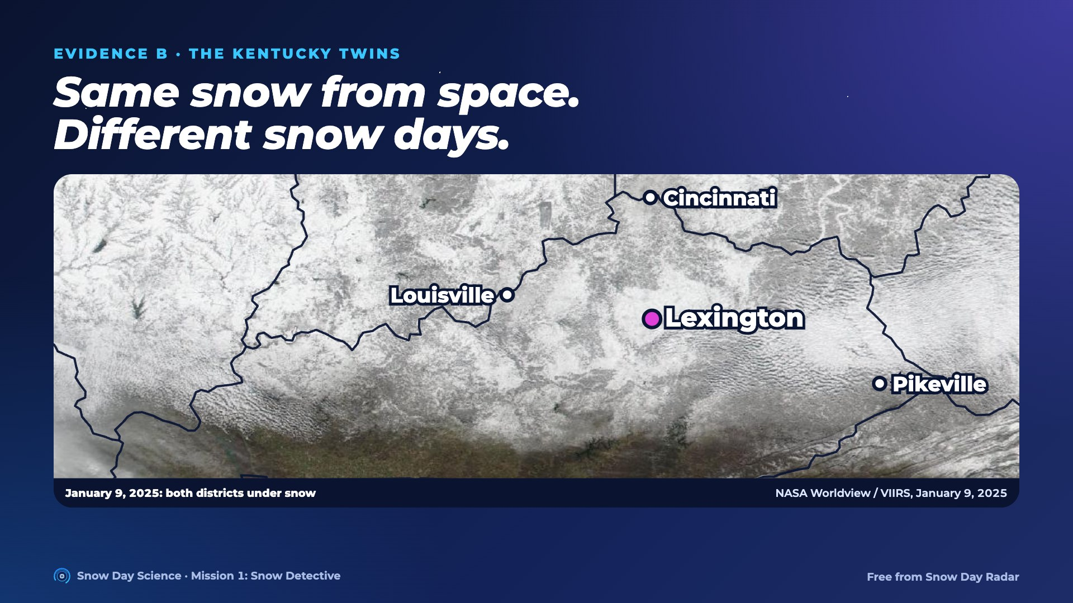
Notes:
This is a real NASA satellite picture after the January 2025 storm. Lexington and Pikeville (Pike County) are both white. They get about the same snow: 13.1 and 14.3 inches a winter.

Slide 7
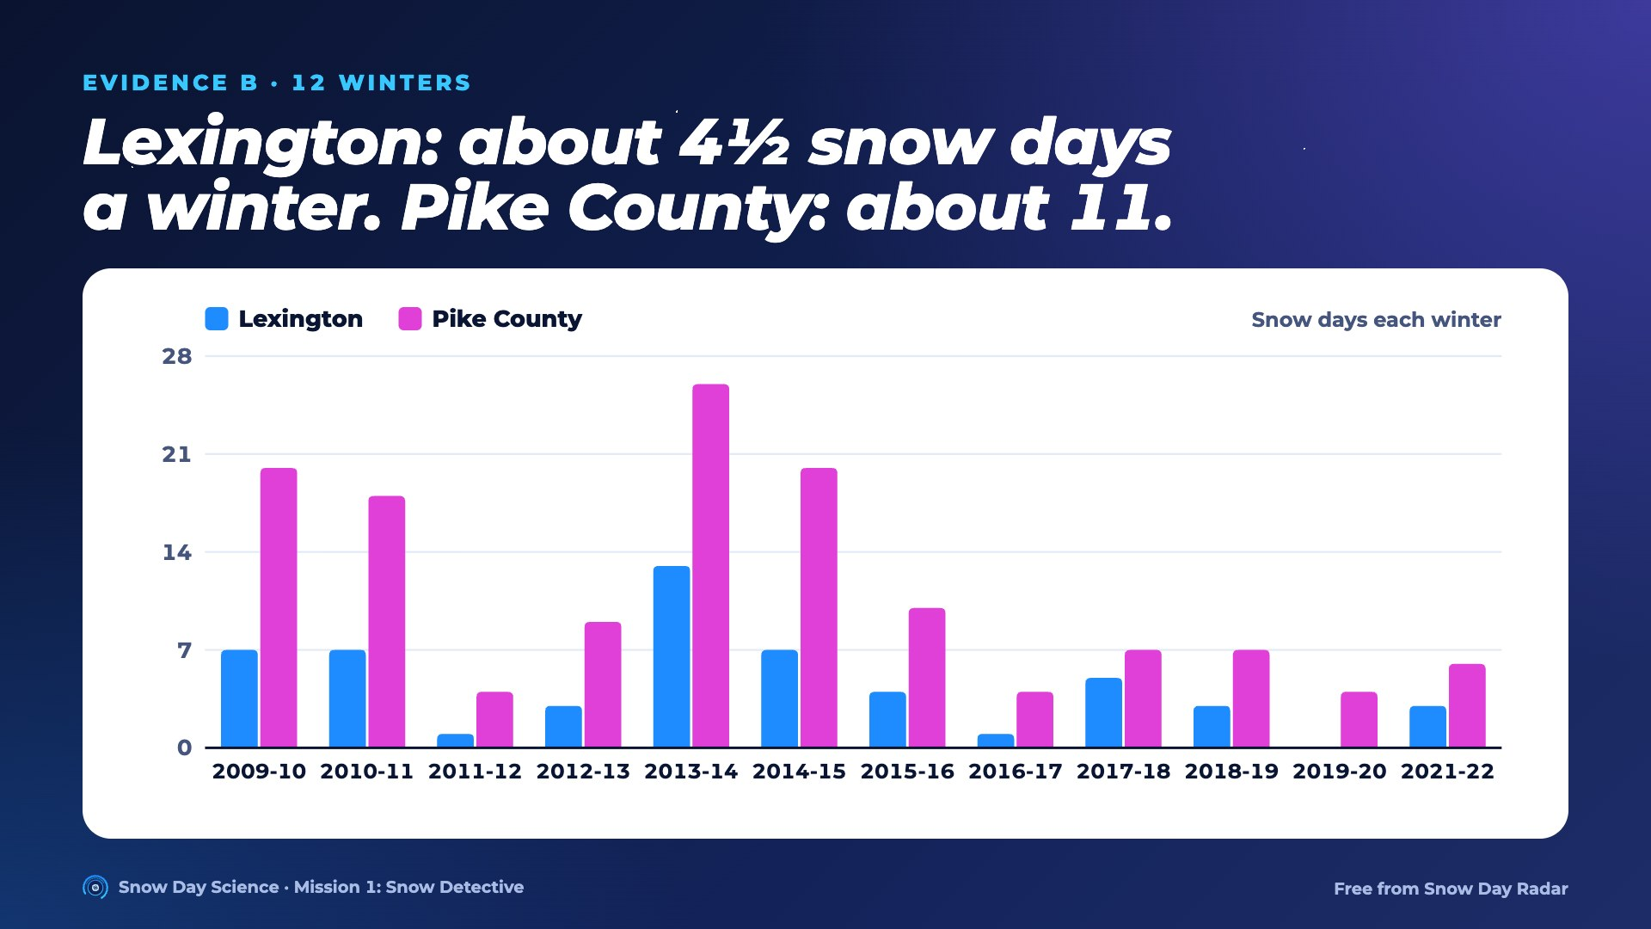
Notes:
Pike County had more snow days every single winter. Same snow, more closures. Why? Let's look at the clues.

Slide 8
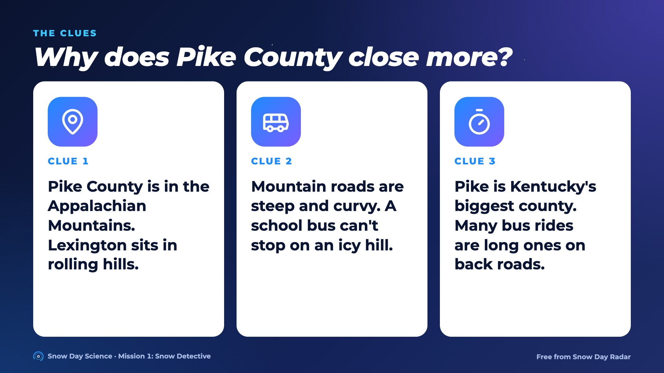
Notes:
Read each clue together. Students use them on Case file B, task 3. The snow isn't the whole story: the trip to school matters.

Slide 9
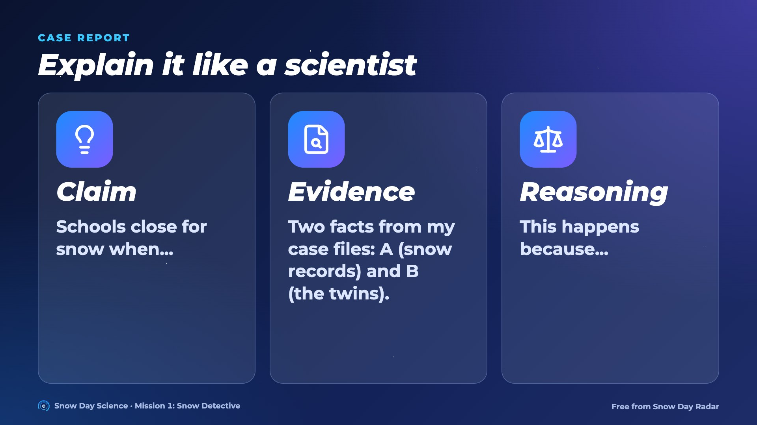
Notes:
Students fill in the Case report page. Strong claims name more than snow: how often it comes, roads, hills and buses.

Slide 10
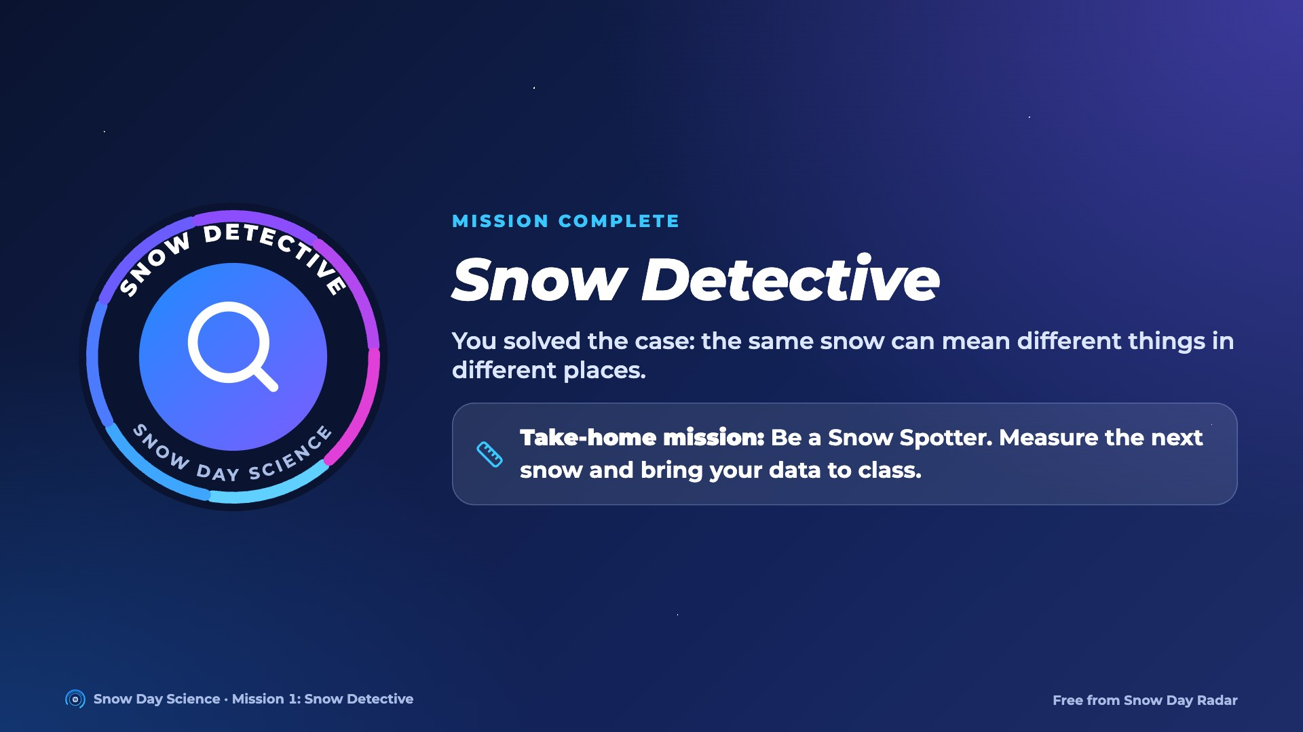
Notes:
Hand out the Snow Detective badge. Send home the Snow Spotter page: next time it snows, measure it like a real weather spotter.

