Slide 1

Notes:
Every card is a real morning from Kentucky Department of Education records and that morning's weather. Use the Mission 2 game sheet to keep score.

Slide 2
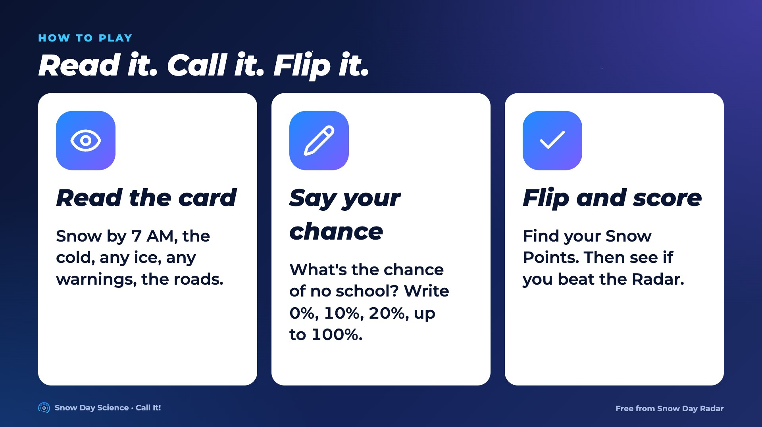
Notes:
Play ten rounds, or all 22 across the winter. Each student writes a chance of no school on the game sheet, then scores Snow Points from the table on the next slide.

Slide 3
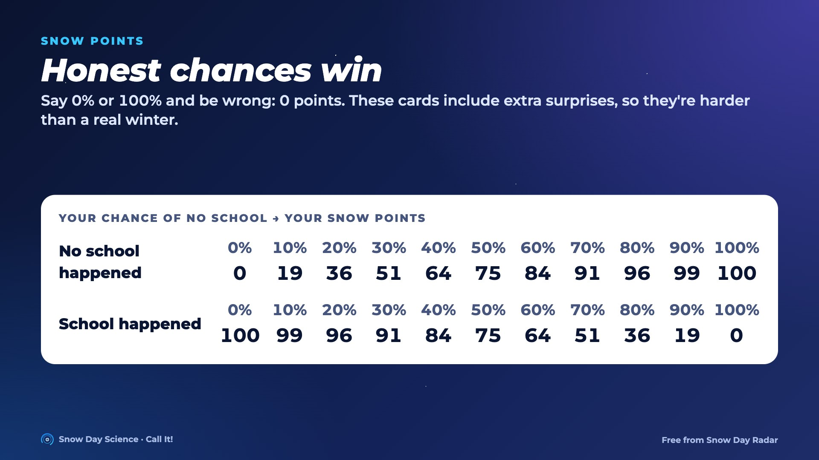
Notes:
Snow Points is the Brier score forecasters are graded on, on a 100-point scale. If you really think it's 30%, saying 30% scores best on average. Over 19,888 real Kentucky mornings, Snow Day Radar averaged 88 points a morning; always saying 50% gets 75.

Slide 4
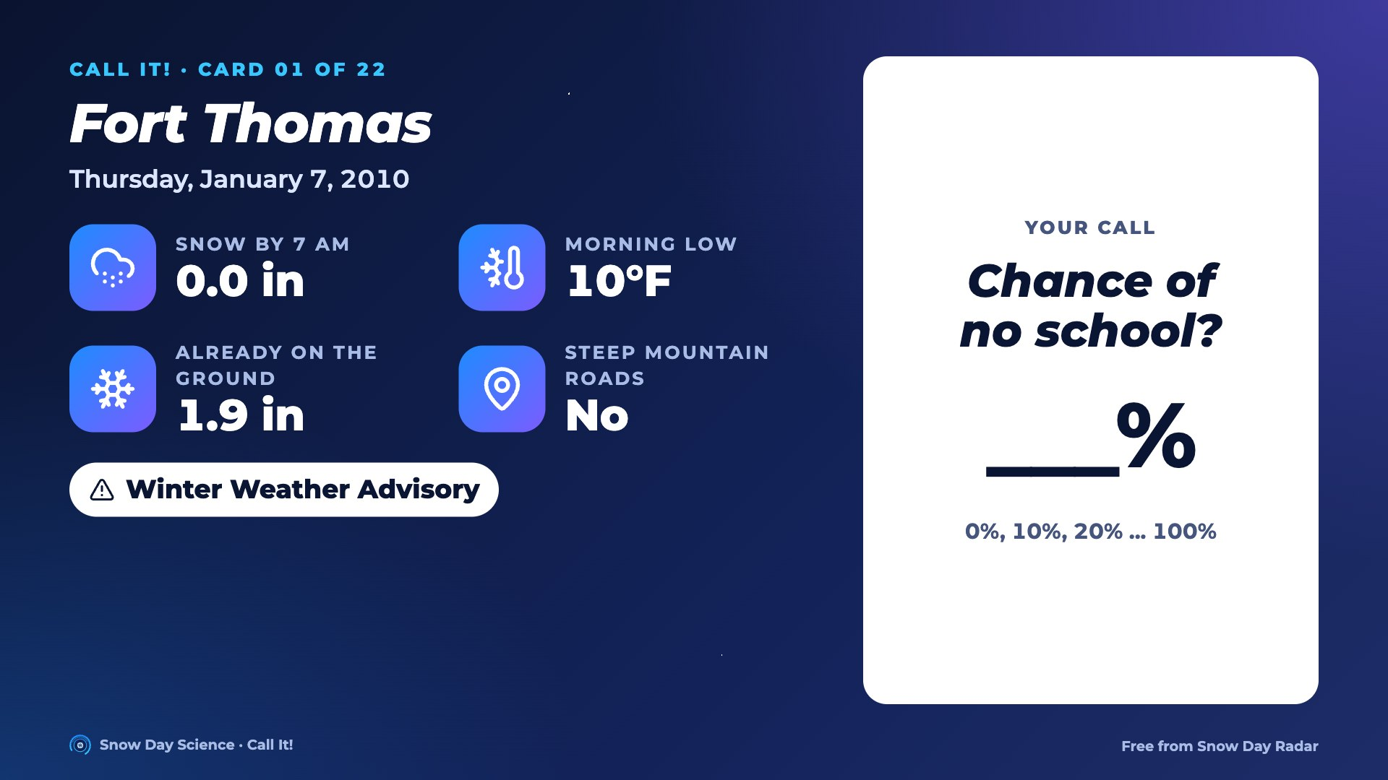
Notes:
Card 01. Read the facts out loud. Everyone writes a chance of no school, 0 to 100%. Then go to the next slide for the answer.

Slide 5
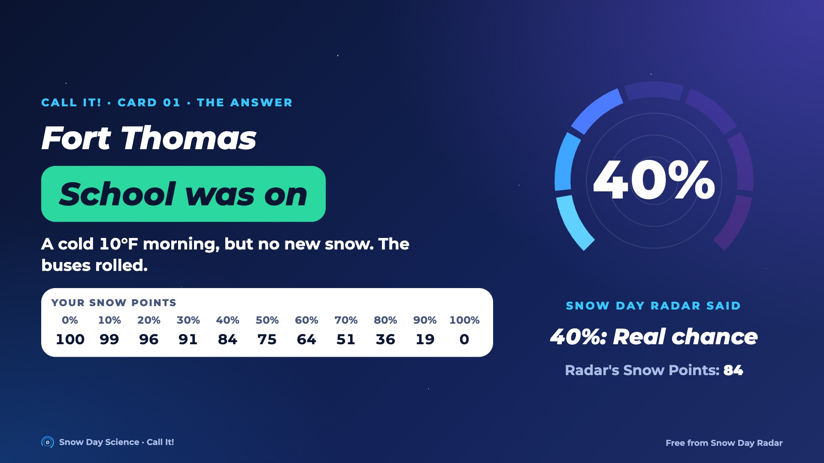
Notes:
Answer for card 01: School was on. Snow Day Radar said 40% in a blind test. A cold 10°F morning, but no new snow. The buses rolled. Students find their Snow Points in the row on screen and compare with the Radar's.

Slide 6
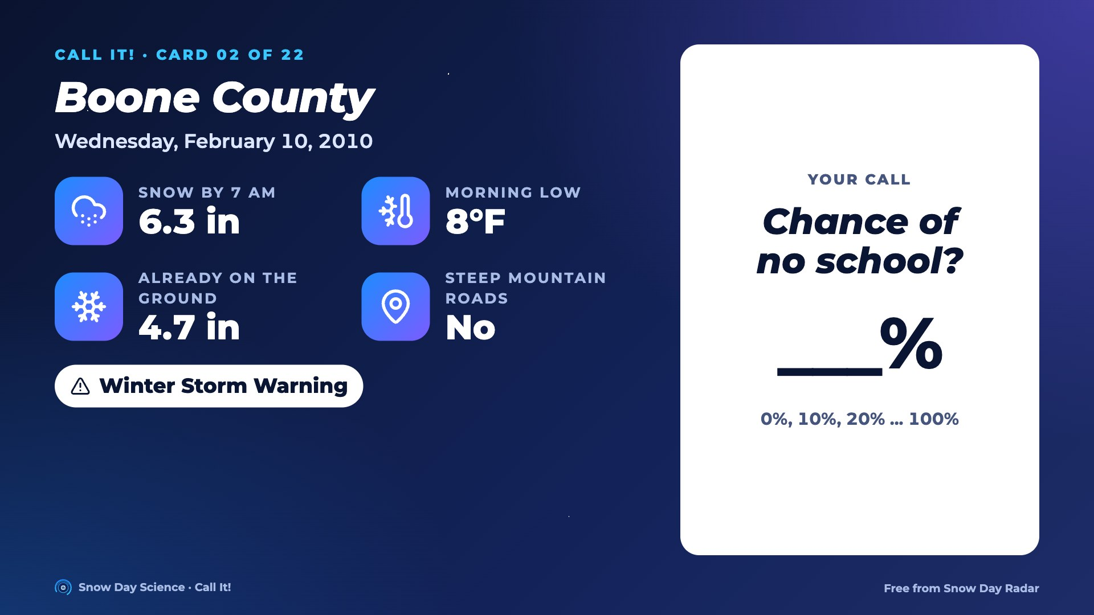
Notes:
Card 02. Read the facts out loud. Everyone writes a chance of no school, 0 to 100%. Then go to the next slide for the answer.

Slide 7
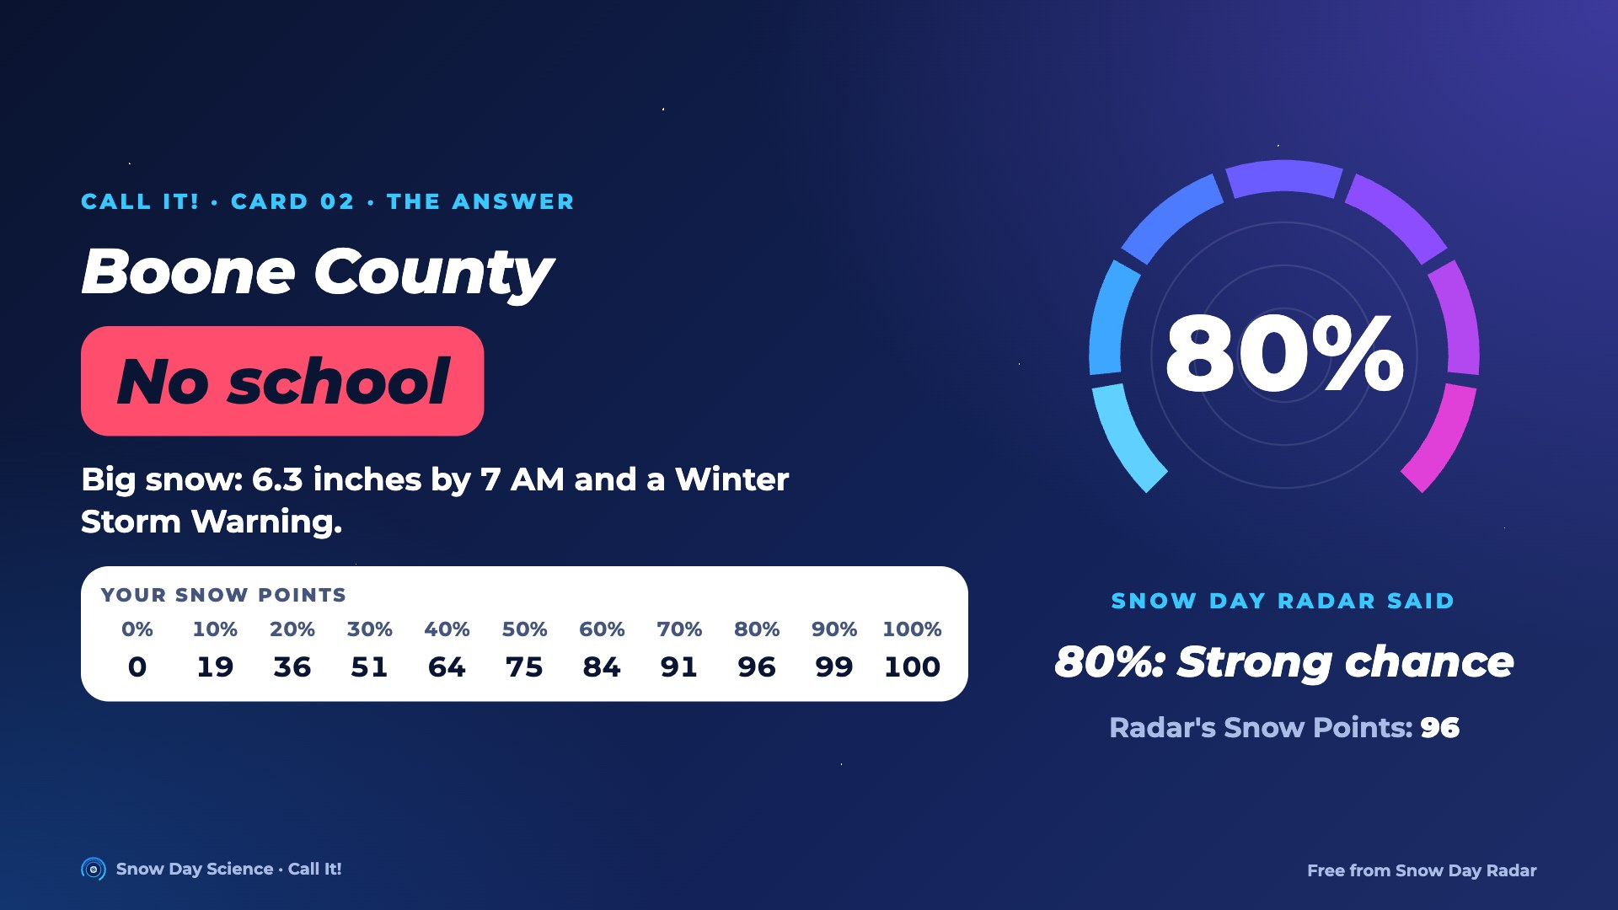
Notes:
Answer for card 02: No school. Snow Day Radar said 80% in a blind test. Big snow: 6.3 inches by 7 AM and a Winter Storm Warning. Students find their Snow Points in the row on screen and compare with the Radar's.

Slide 8
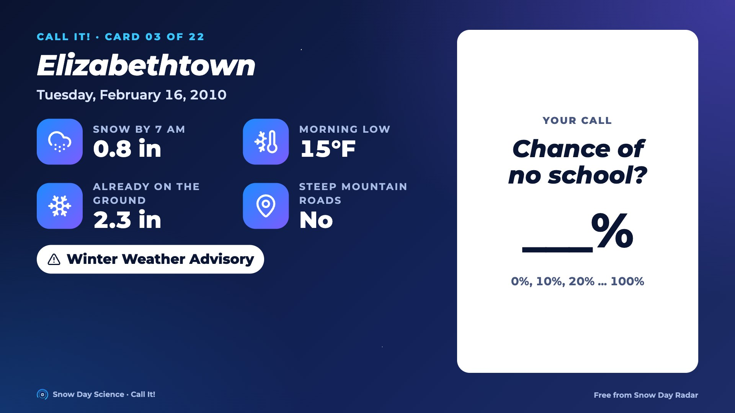
Notes:
Card 03. Read the facts out loud. Everyone writes a chance of no school, 0 to 100%. Then go to the next slide for the answer.

Slide 9
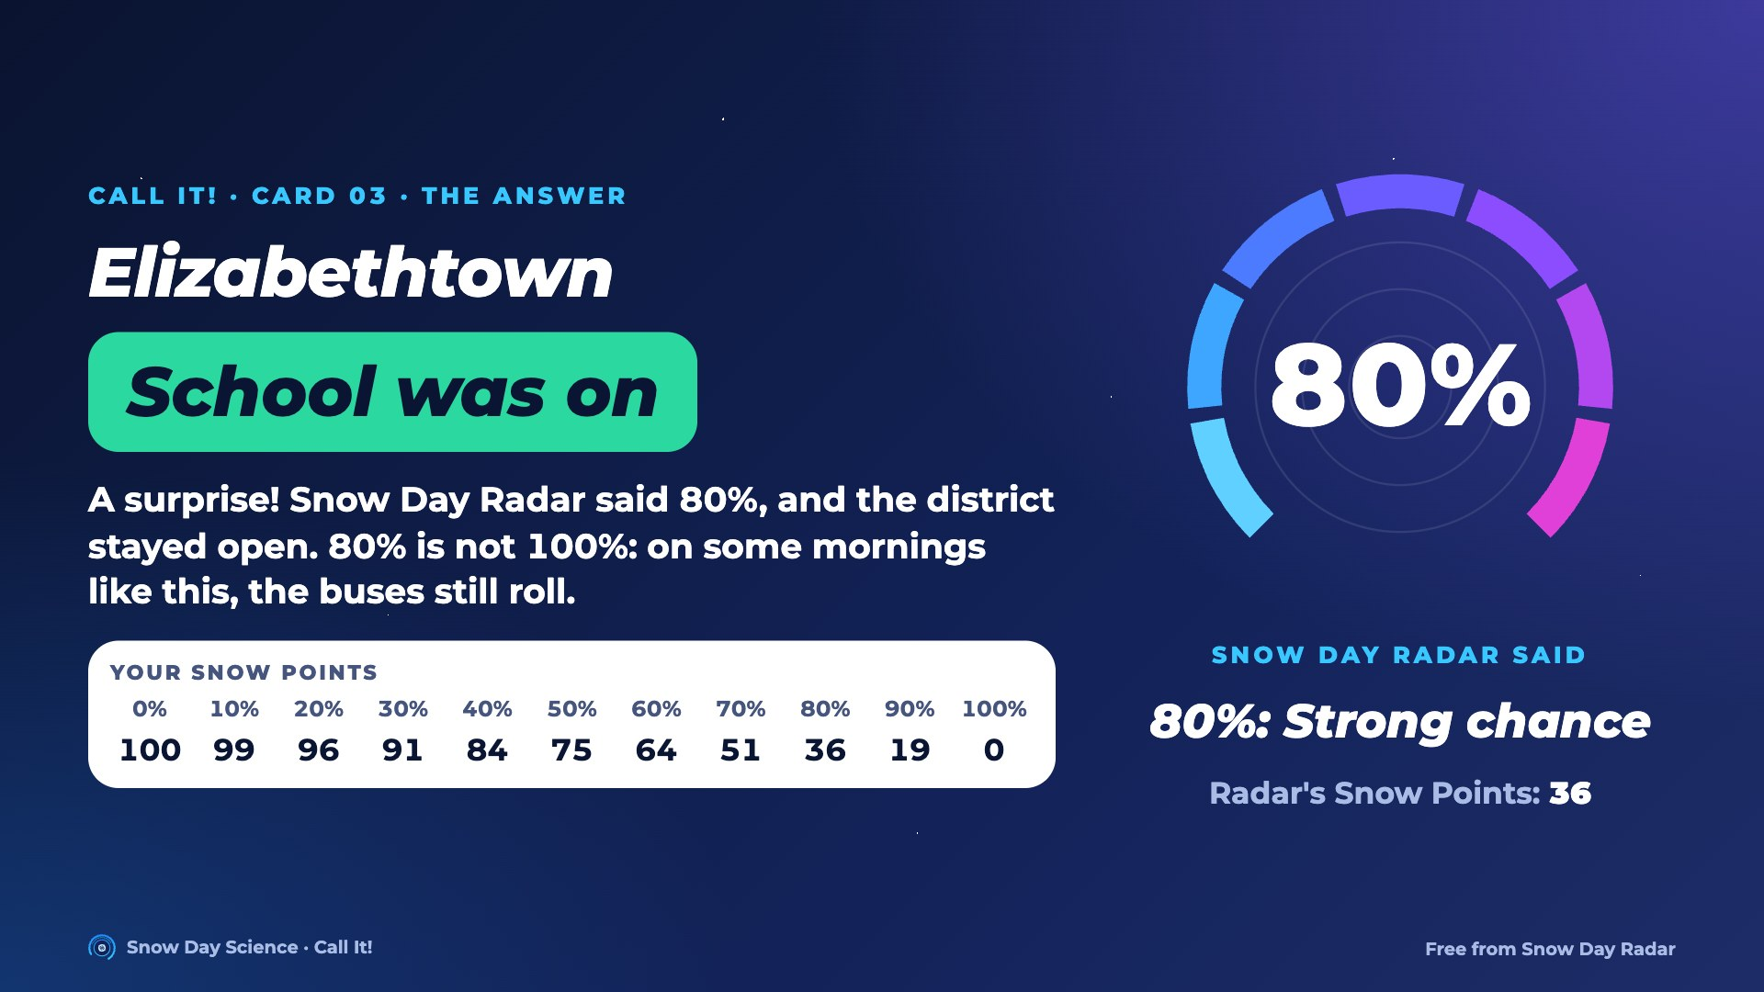
Notes:
Answer for card 03: School was on. Snow Day Radar said 80% in a blind test. A surprise! Snow Day Radar said 80%, and the district stayed open. 80% is not 100%: on some mornings like this, the buses still roll. Students find their Snow Points in the row on screen and compare with the Radar's.

Slide 10
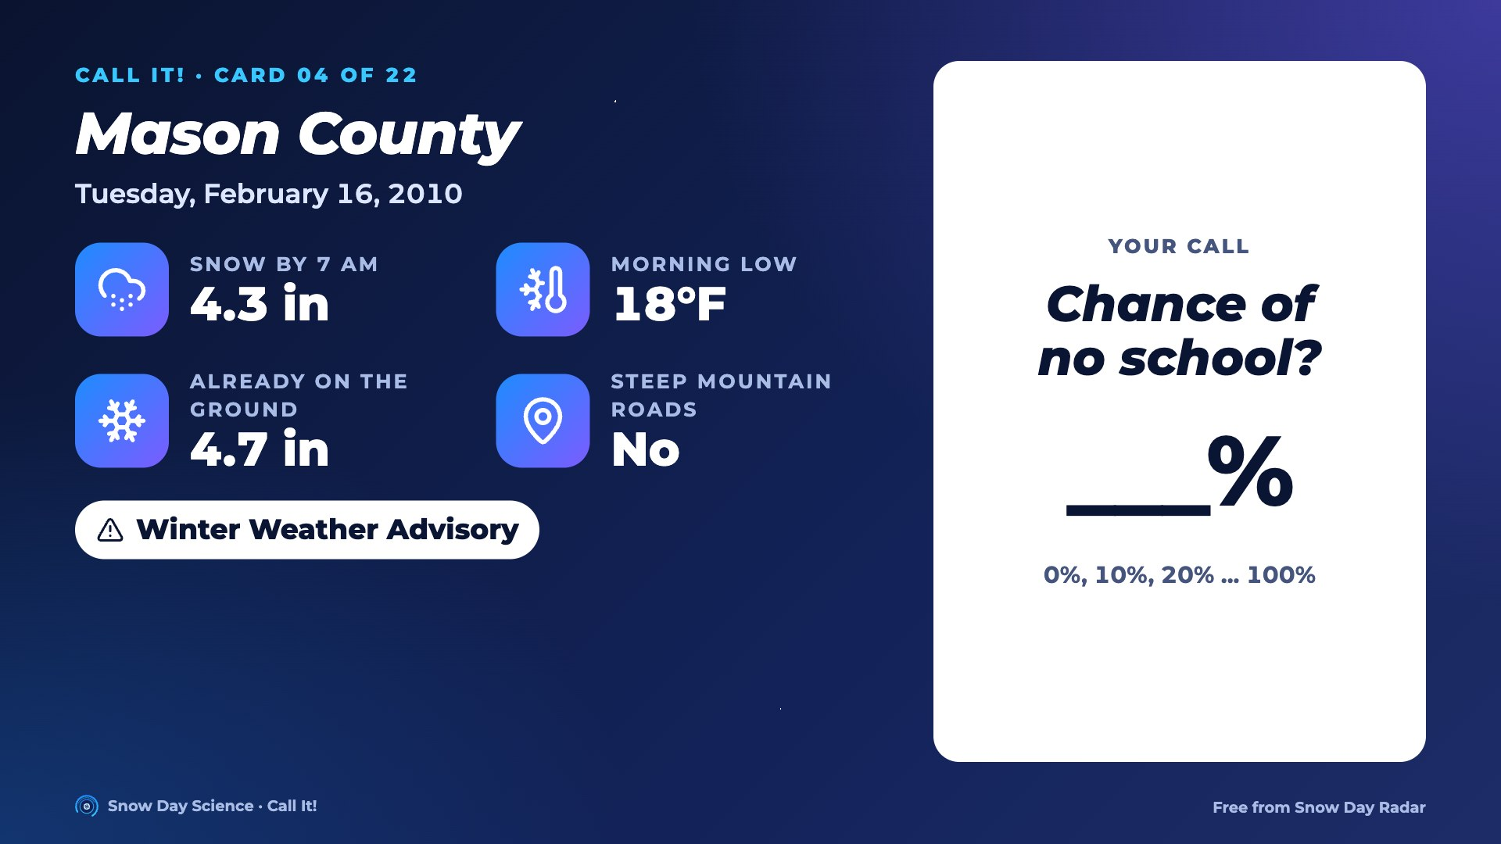
Notes:
Card 04. Read the facts out loud. Everyone writes a chance of no school, 0 to 100%. Then go to the next slide for the answer.

Slide 11
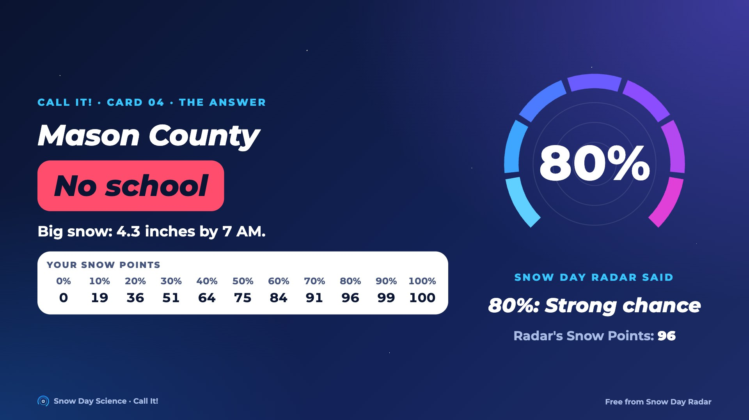
Notes:
Answer for card 04: No school. Snow Day Radar said 80% in a blind test. Big snow: 4.3 inches by 7 AM. Students find their Snow Points in the row on screen and compare with the Radar's.

Slide 12
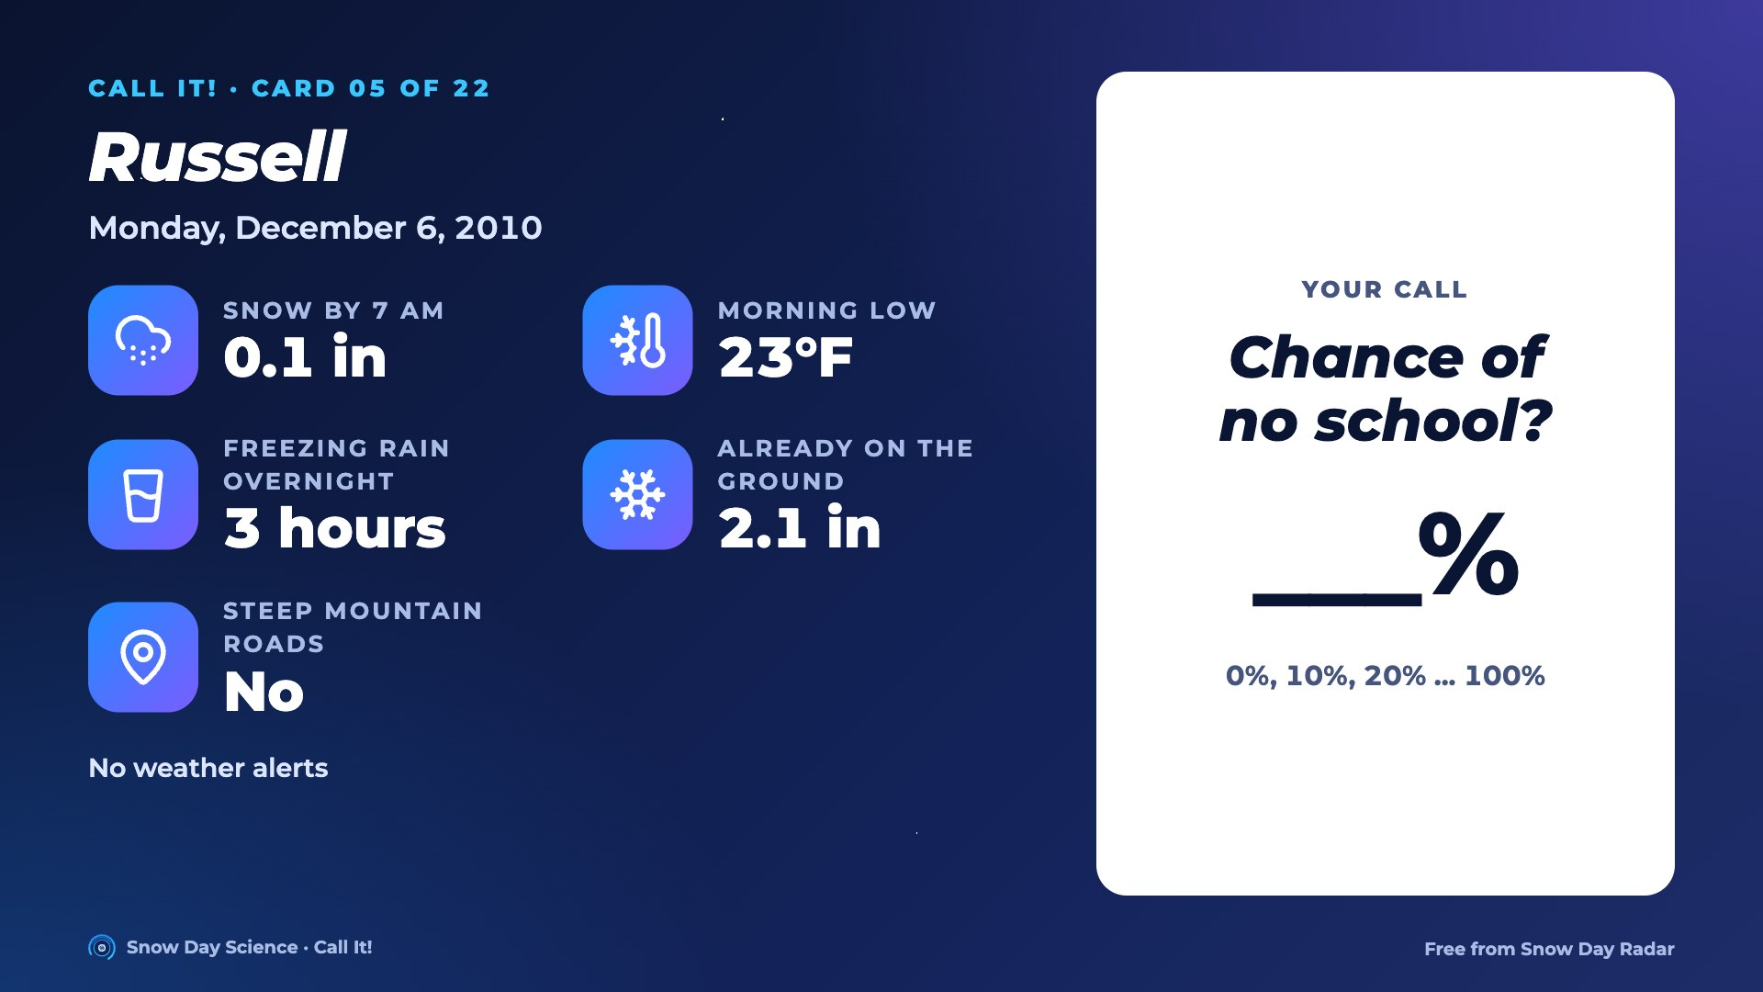
Notes:
Card 05. Read the facts out loud. Everyone writes a chance of no school, 0 to 100%. Then go to the next slide for the answer.

Slide 13
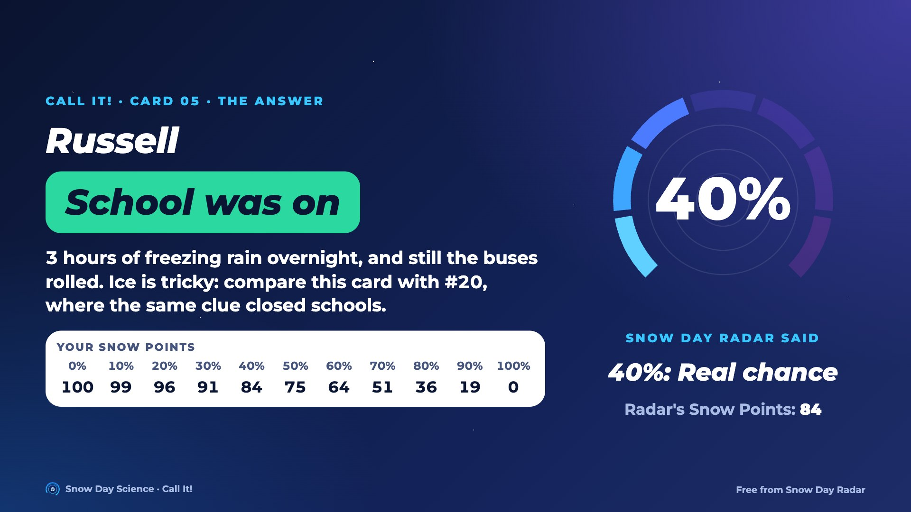
Notes:
Answer for card 05: School was on. Snow Day Radar said 40% in a blind test. 3 hours of freezing rain overnight, and still the buses rolled. Ice is tricky: compare this card with #20, where the same clue closed schools. Students find their Snow Points in the row on screen and compare with the Radar's.

Slide 14
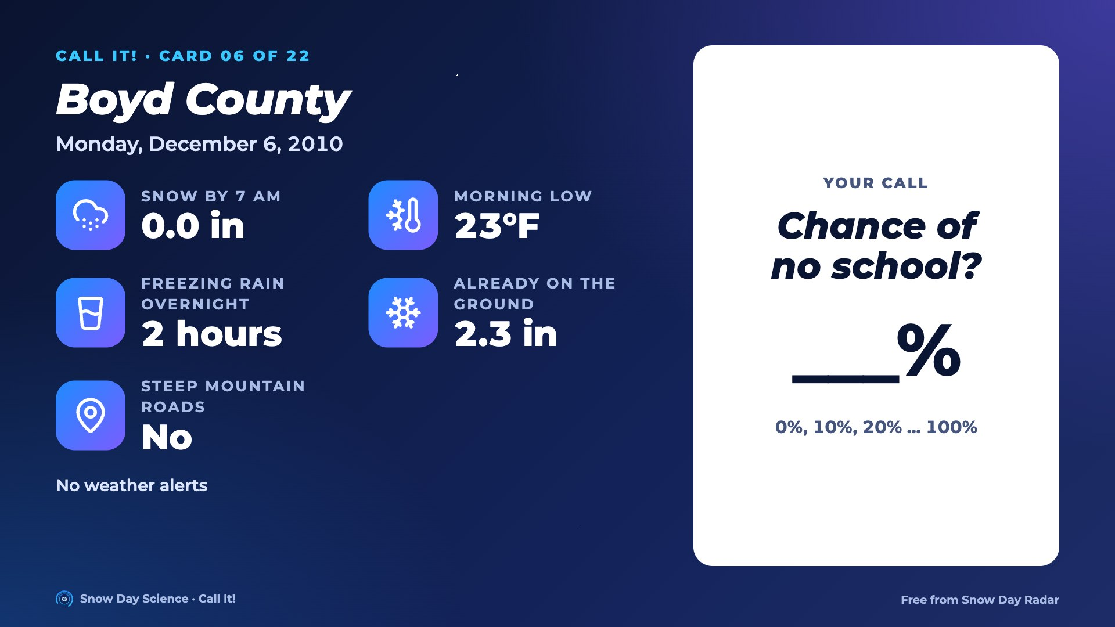
Notes:
Card 06. Read the facts out loud. Everyone writes a chance of no school, 0 to 100%. Then go to the next slide for the answer.

Slide 15
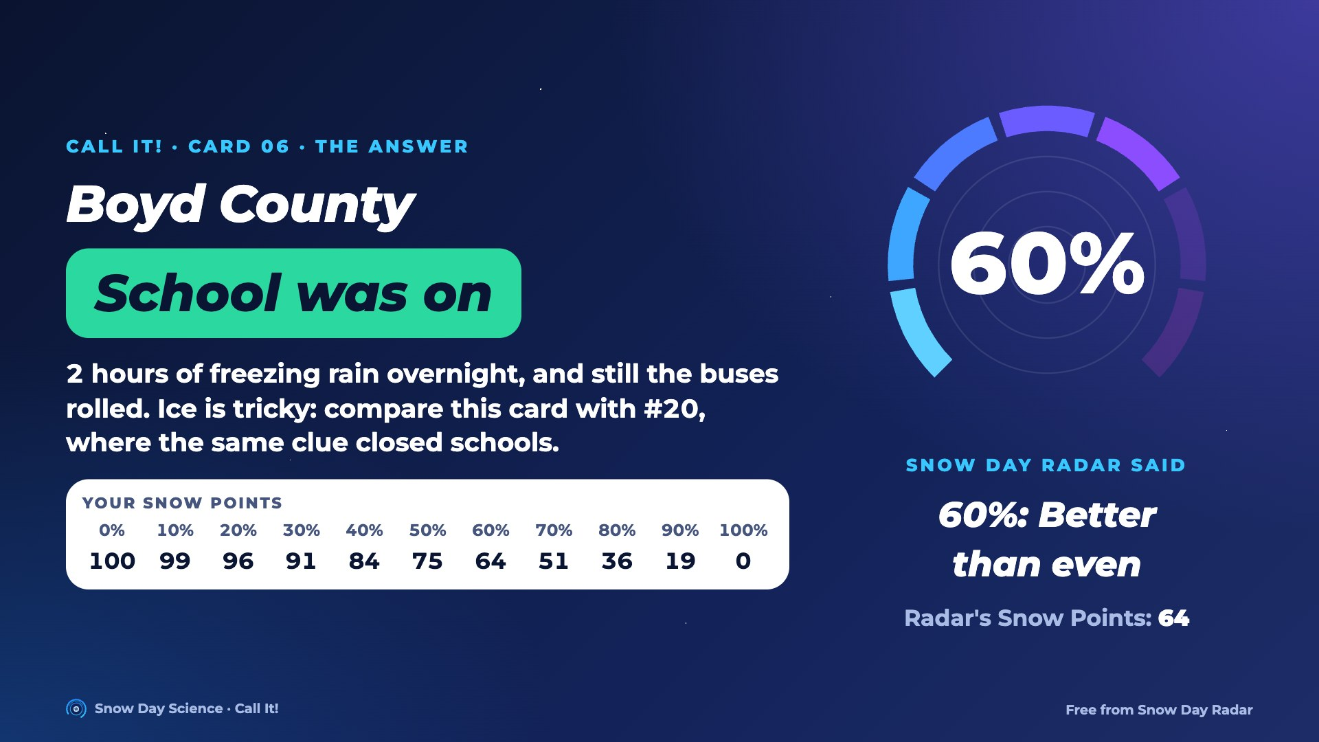
Notes:
Answer for card 06: School was on. Snow Day Radar said 60% in a blind test. 2 hours of freezing rain overnight, and still the buses rolled. Ice is tricky: compare this card with #20, where the same clue closed schools. Students find their Snow Points in the row on screen and compare with the Radar's.

Slide 16
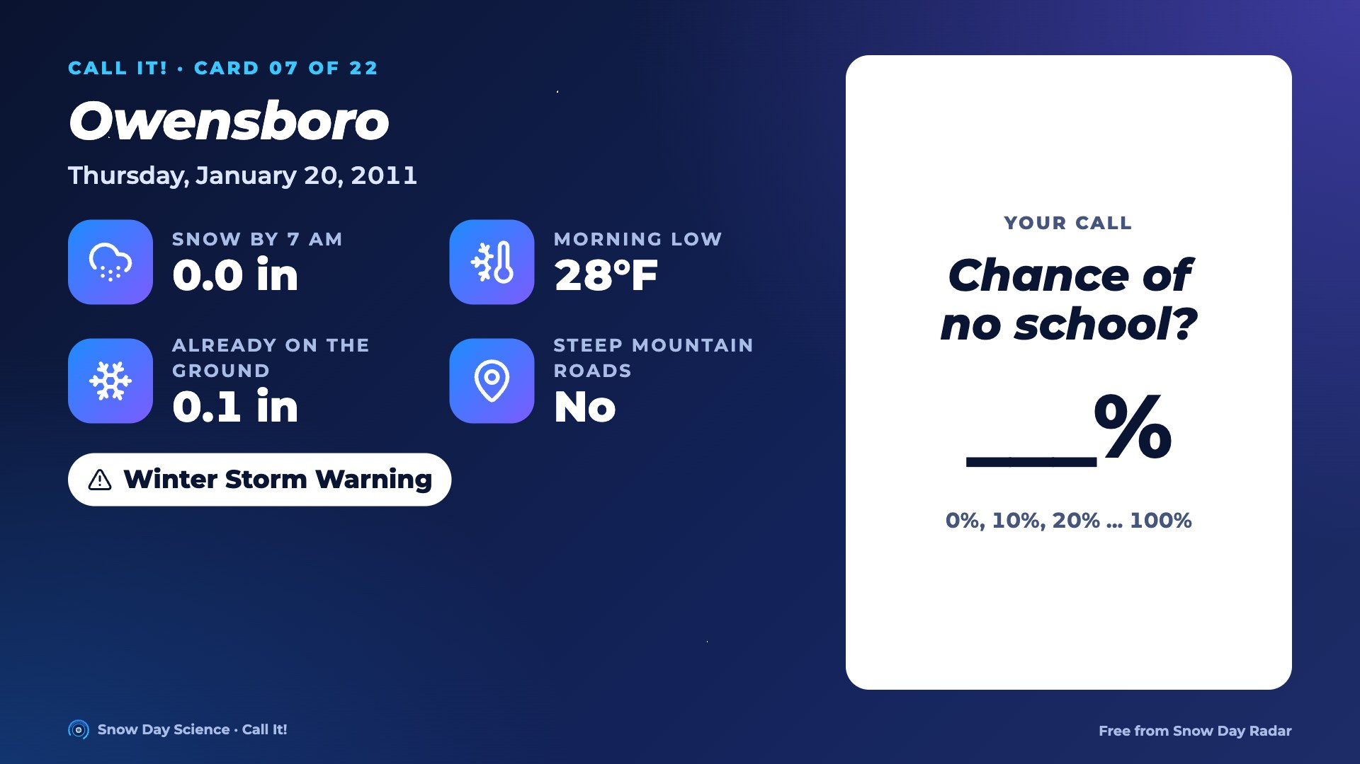
Notes:
Card 07. Read the facts out loud. Everyone writes a chance of no school, 0 to 100%. Then go to the next slide for the answer.

Slide 17
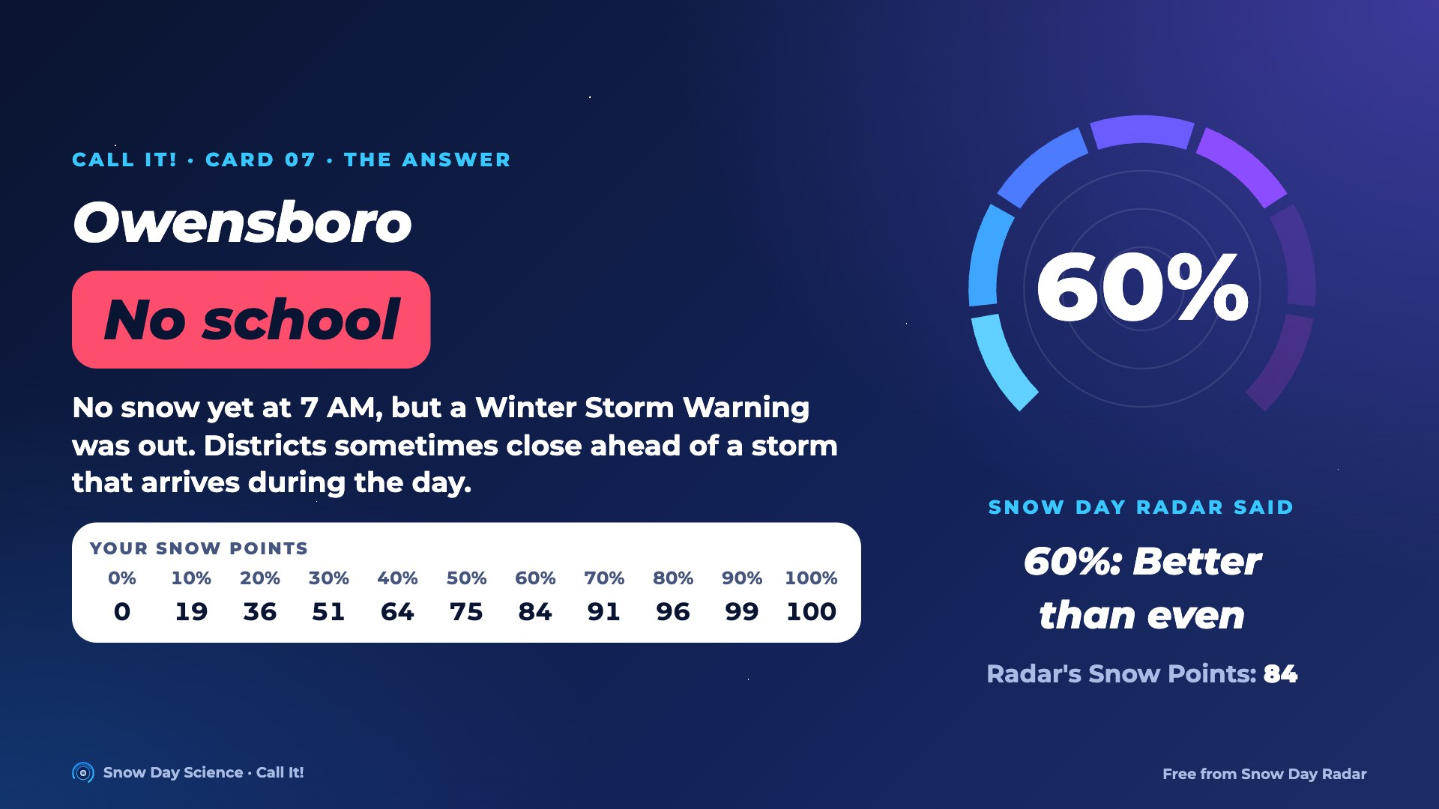
Notes:
Answer for card 07: No school. Snow Day Radar said 60% in a blind test. No snow yet at 7 AM, but a Winter Storm Warning was out. Districts sometimes close ahead of a storm that arrives during the day. Students find their Snow Points in the row on screen and compare with the Radar's.

Slide 18
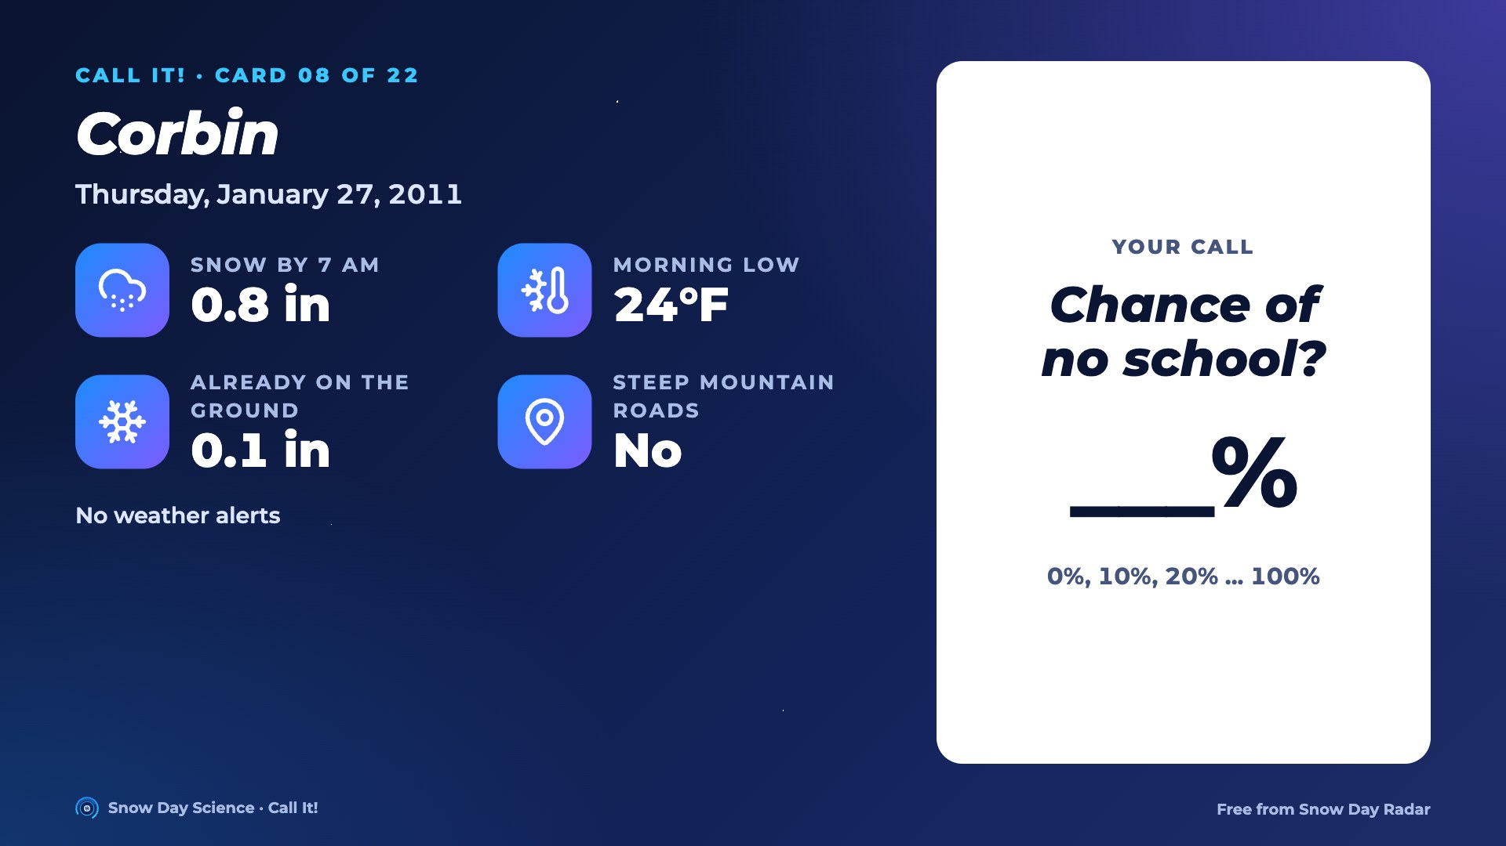
Notes:
Card 08. Read the facts out loud. Everyone writes a chance of no school, 0 to 100%. Then go to the next slide for the answer.

Slide 19
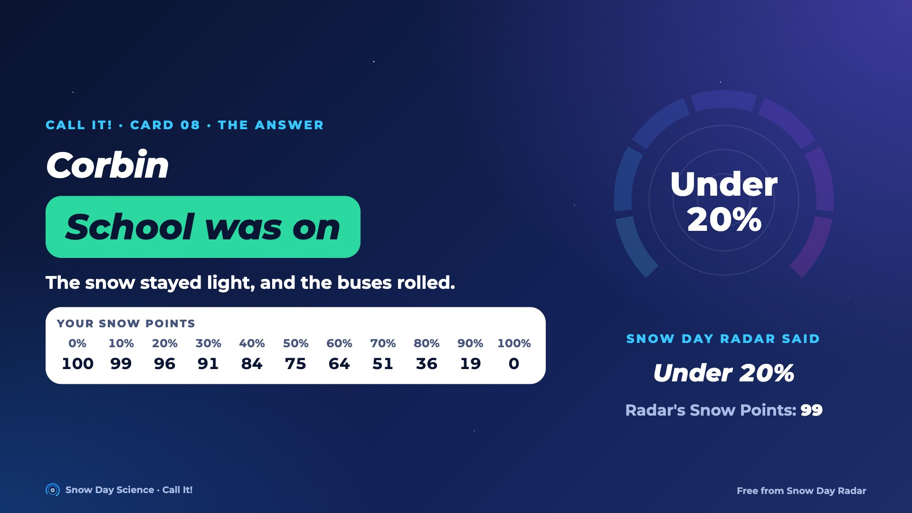
Notes:
Answer for card 08: School was on. Snow Day Radar said under 20% in a blind test. The snow stayed light, and the buses rolled. Students find their Snow Points in the row on screen and compare with the Radar's.

Slide 20
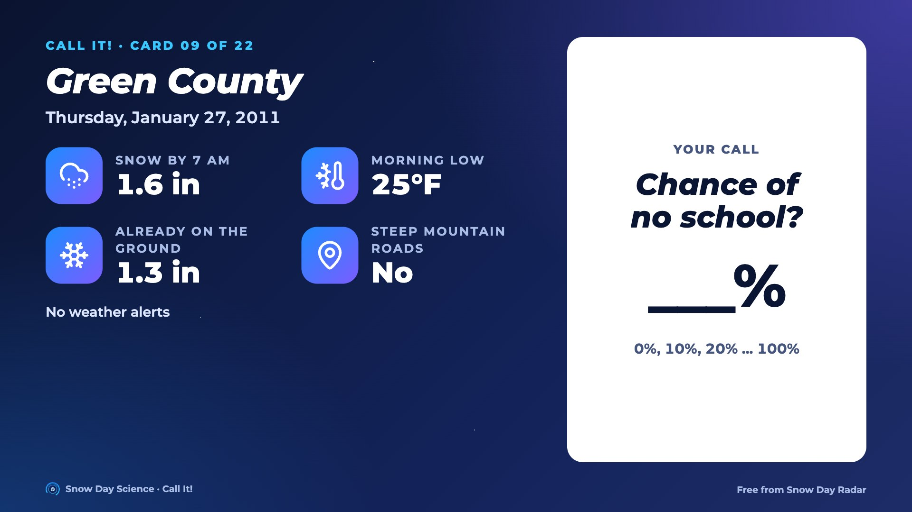
Notes:
Card 09. Read the facts out loud. Everyone writes a chance of no school, 0 to 100%. Then go to the next slide for the answer.

Slide 21
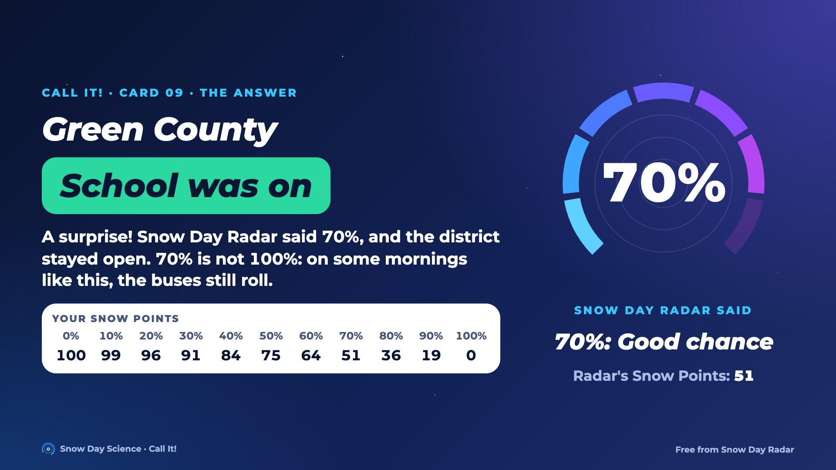
Notes:
Answer for card 09: School was on. Snow Day Radar said 70% in a blind test. A surprise! Snow Day Radar said 70%, and the district stayed open. 70% is not 100%: on some mornings like this, the buses still roll. Students find their Snow Points in the row on screen and compare with the Radar's.

Slide 22

Notes:
Card 10. Read the facts out loud. Everyone writes a chance of no school, 0 to 100%. Then go to the next slide for the answer.

Slide 23
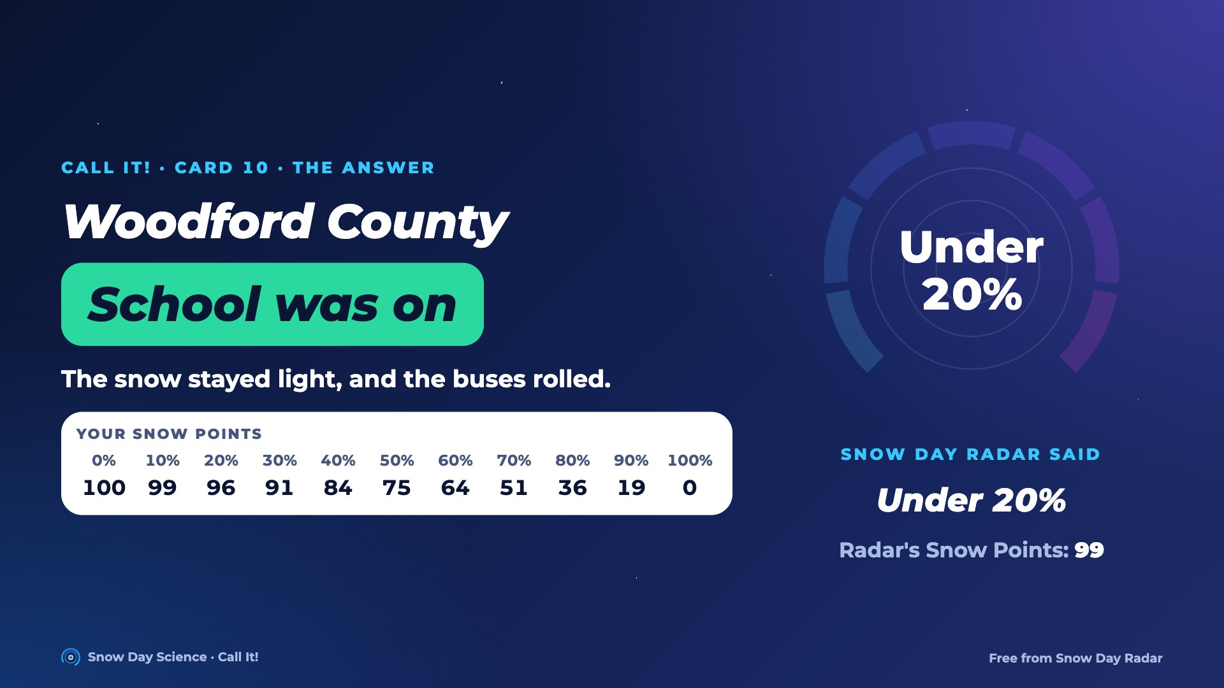
Notes:
Answer for card 10: School was on. Snow Day Radar said under 20% in a blind test. The snow stayed light, and the buses rolled. Students find their Snow Points in the row on screen and compare with the Radar's.

Slide 24

Notes:
Card 11. Read the facts out loud. Everyone writes a chance of no school, 0 to 100%. Then go to the next slide for the answer.

Slide 25
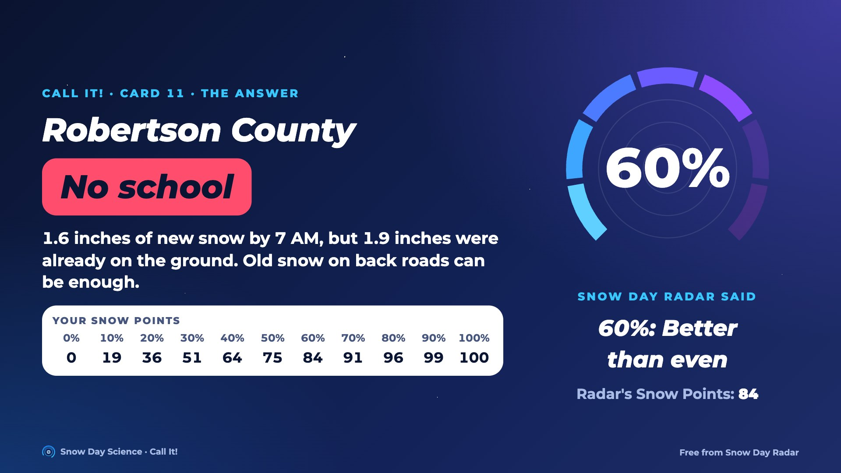
Notes:
Answer for card 11: No school. Snow Day Radar said 60% in a blind test. 1.6 inches of new snow by 7 AM, but 1.9 inches were already on the ground. Old snow on back roads can be enough. Students find their Snow Points in the row on screen and compare with the Radar's.

Slide 26
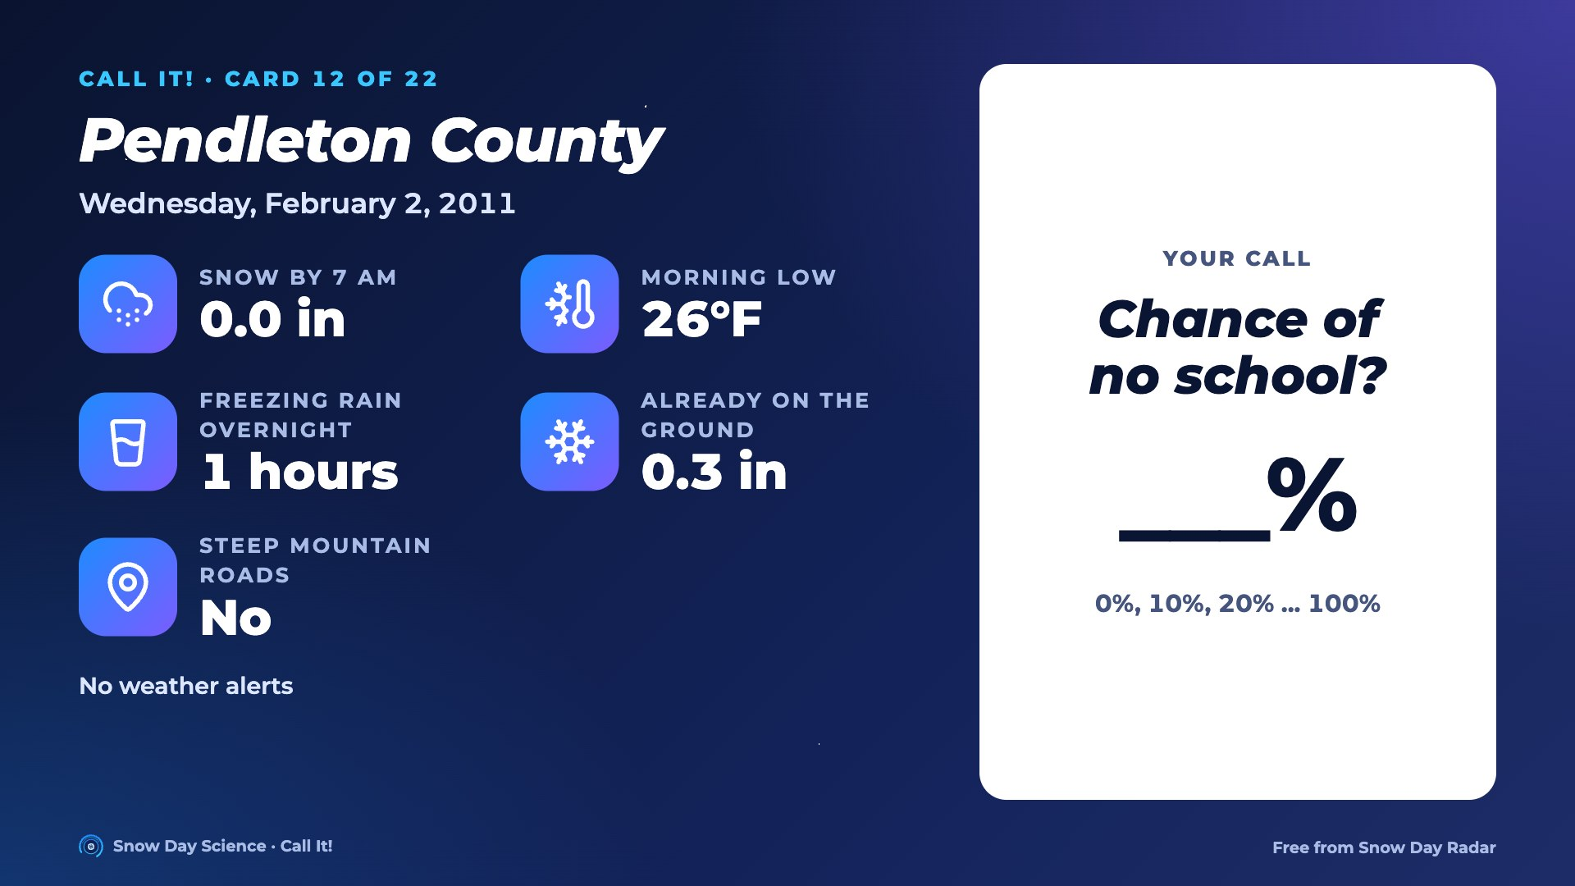
Notes:
Card 12. Read the facts out loud. Everyone writes a chance of no school, 0 to 100%. Then go to the next slide for the answer.

Slide 27
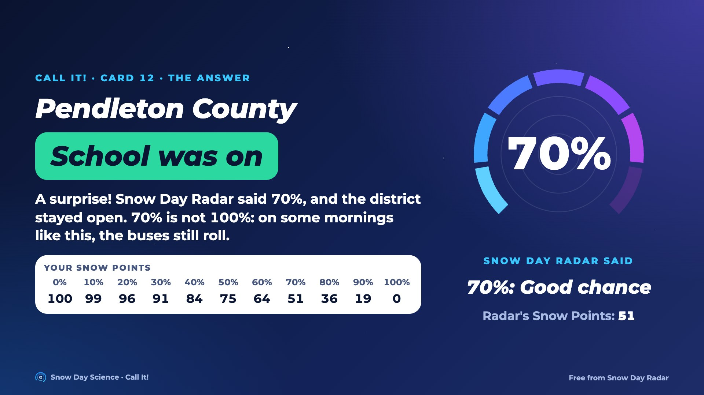
Notes:
Answer for card 12: School was on. Snow Day Radar said 70% in a blind test. A surprise! Snow Day Radar said 70%, and the district stayed open. 70% is not 100%: on some mornings like this, the buses still roll. Students find their Snow Points in the row on screen and compare with the Radar's.

Slide 28
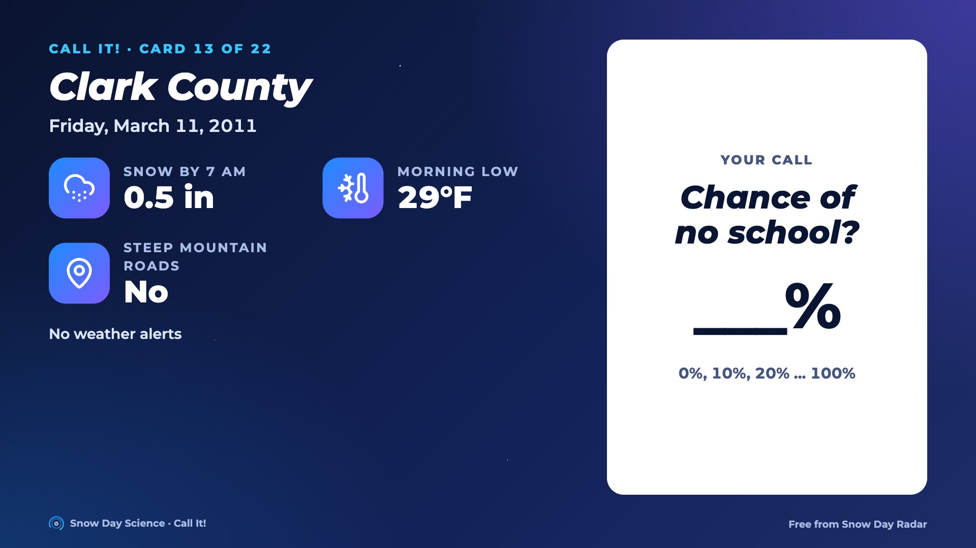
Notes:
Card 13. Read the facts out loud. Everyone writes a chance of no school, 0 to 100%. Then go to the next slide for the answer.

Slide 29
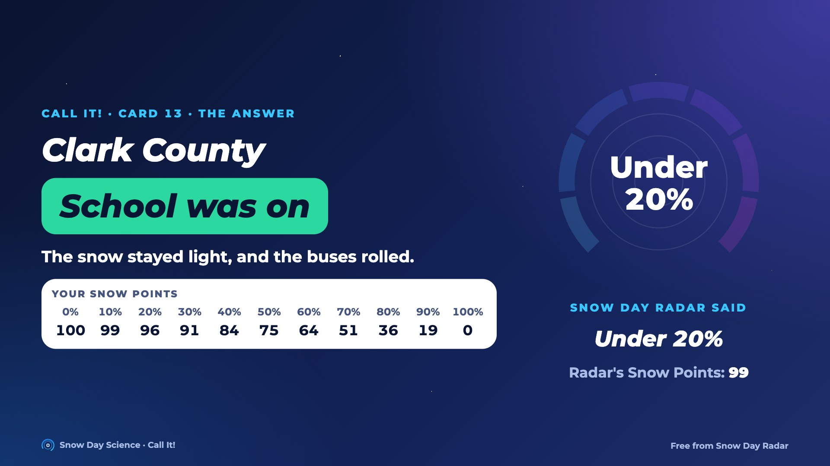
Notes:
Answer for card 13: School was on. Snow Day Radar said under 20% in a blind test. The snow stayed light, and the buses rolled. Students find their Snow Points in the row on screen and compare with the Radar's.

Slide 30
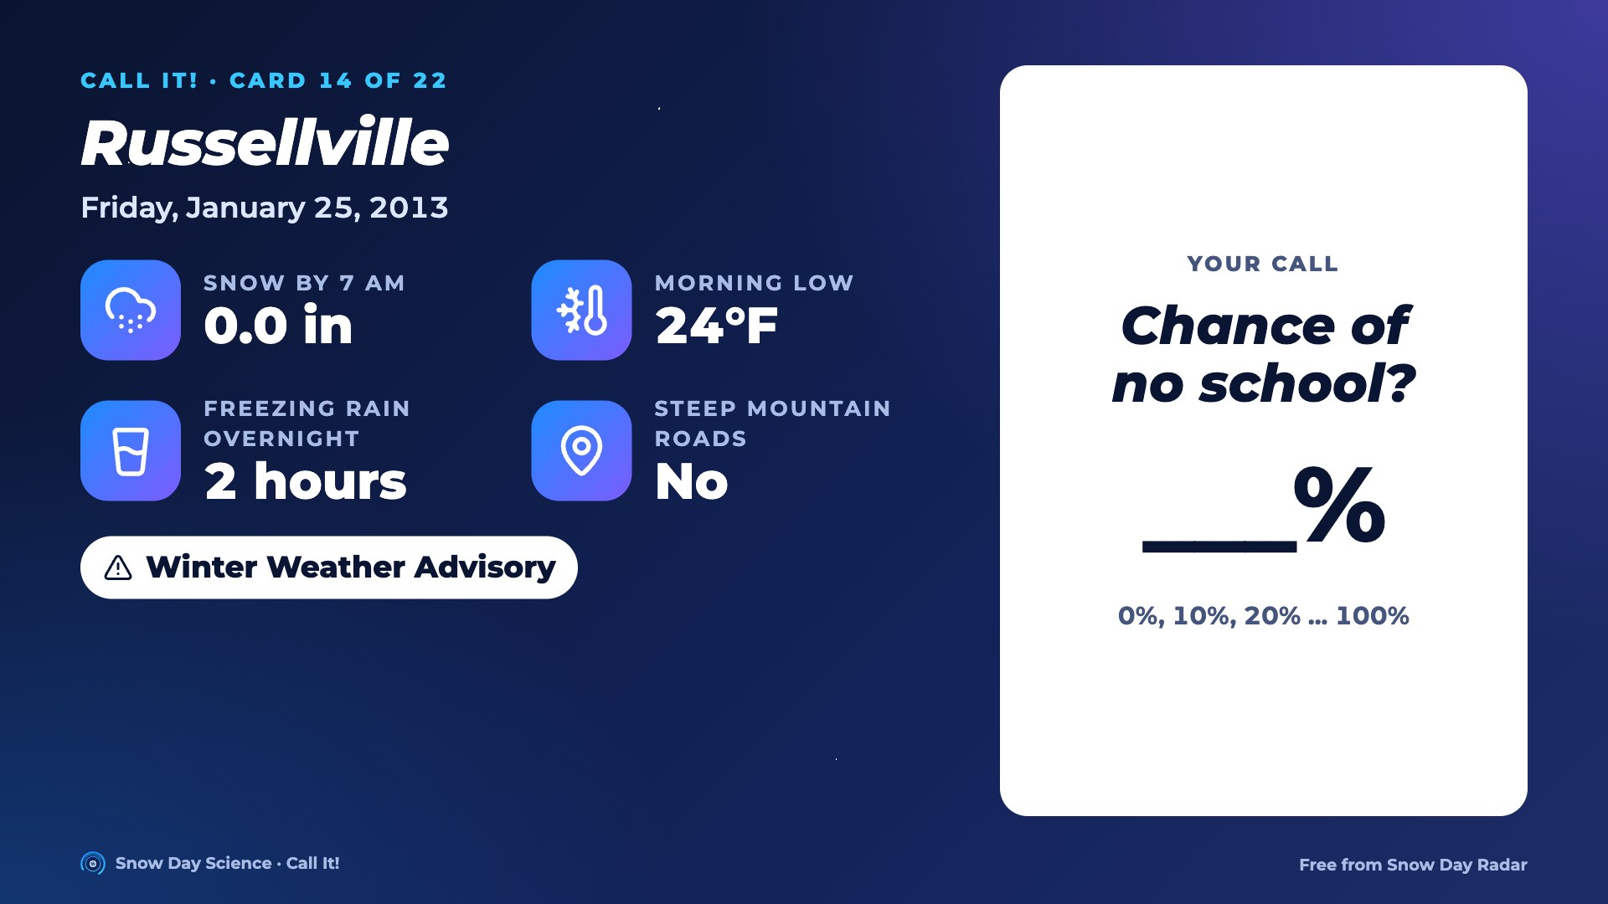
Notes:
Card 14. Read the facts out loud. Everyone writes a chance of no school, 0 to 100%. Then go to the next slide for the answer.

Slide 31
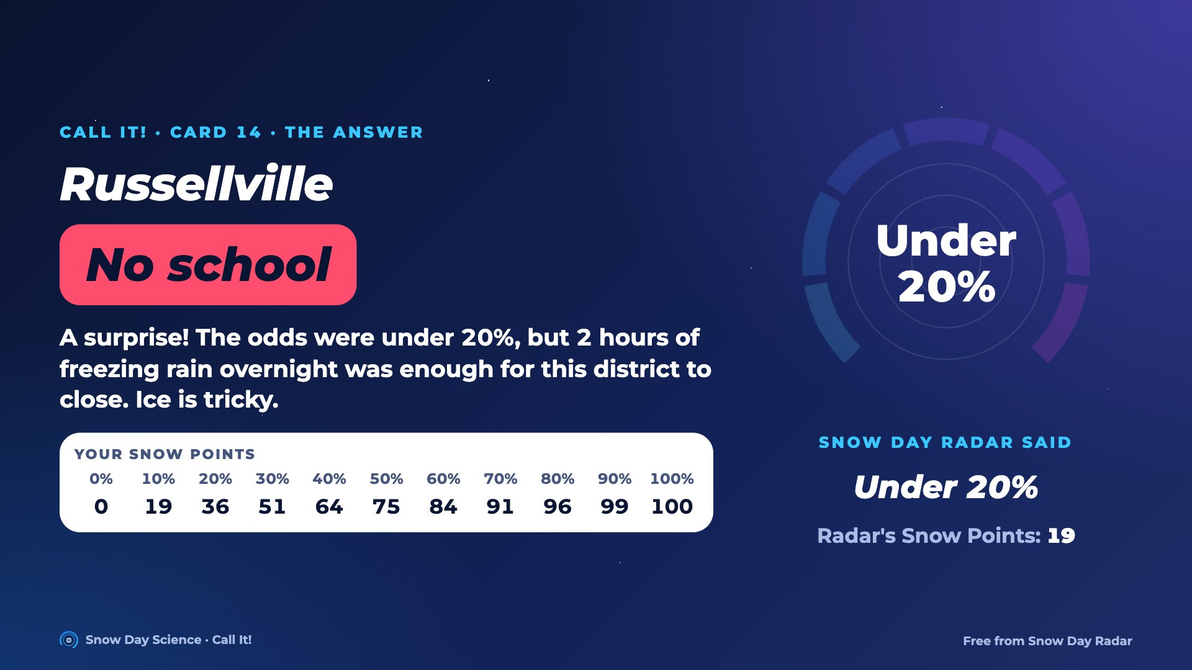
Notes:
Answer for card 14: No school. Snow Day Radar said under 20% in a blind test. A surprise! The odds were under 20%, but 2 hours of freezing rain overnight was enough for this district to close. Ice is tricky. Students find their Snow Points in the row on screen and compare with the Radar's.

Slide 32

Notes:
Card 15. Read the facts out loud. Everyone writes a chance of no school, 0 to 100%. Then go to the next slide for the answer.

Slide 33
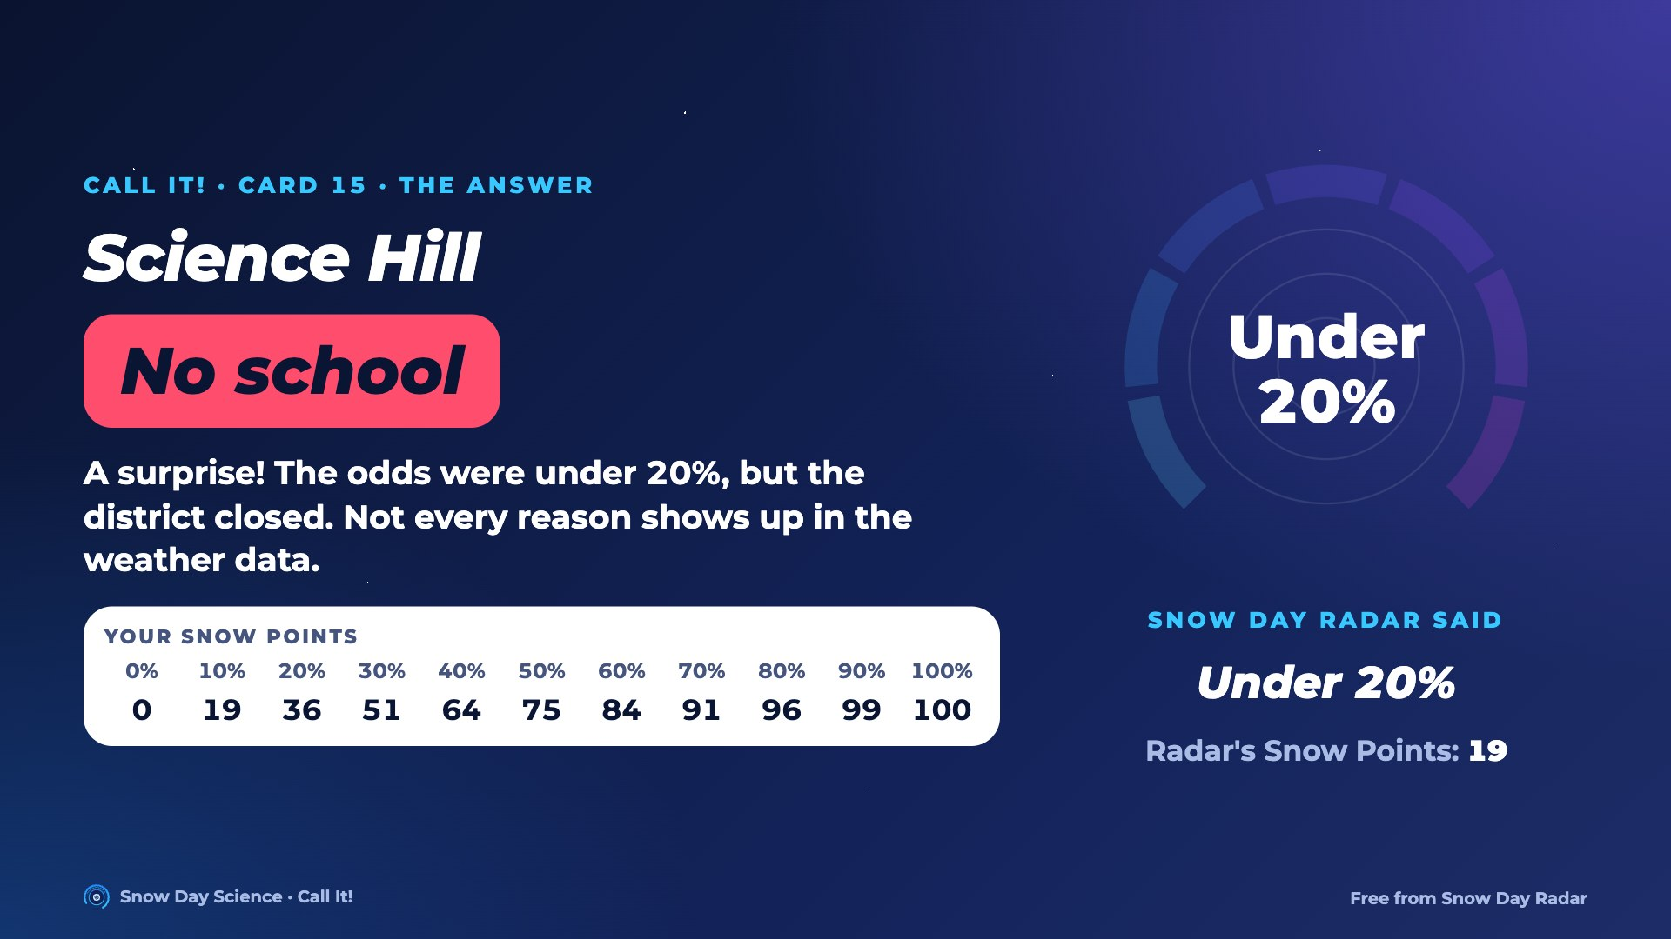
Notes:
Answer for card 15: No school. Snow Day Radar said under 20% in a blind test. A surprise! The odds were under 20%, but the district closed. Not every reason shows up in the weather data. Students find their Snow Points in the row on screen and compare with the Radar's.

Slide 34

Notes:
Card 16. Read the facts out loud. Everyone writes a chance of no school, 0 to 100%. Then go to the next slide for the answer.

Slide 35
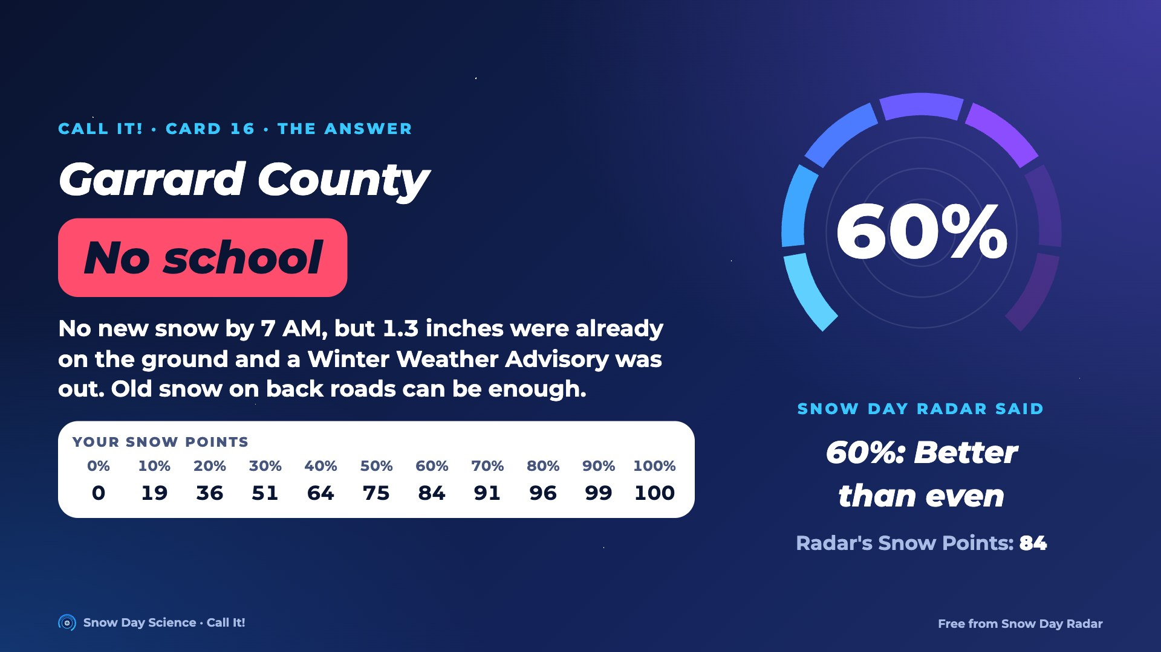
Notes:
Answer for card 16: No school. Snow Day Radar said 60% in a blind test. No new snow by 7 AM, but 1.3 inches were already on the ground and a Winter Weather Advisory was out. Old snow on back roads can be enough. Students find their Snow Points in the row on screen and compare with the Radar's.

Slide 36
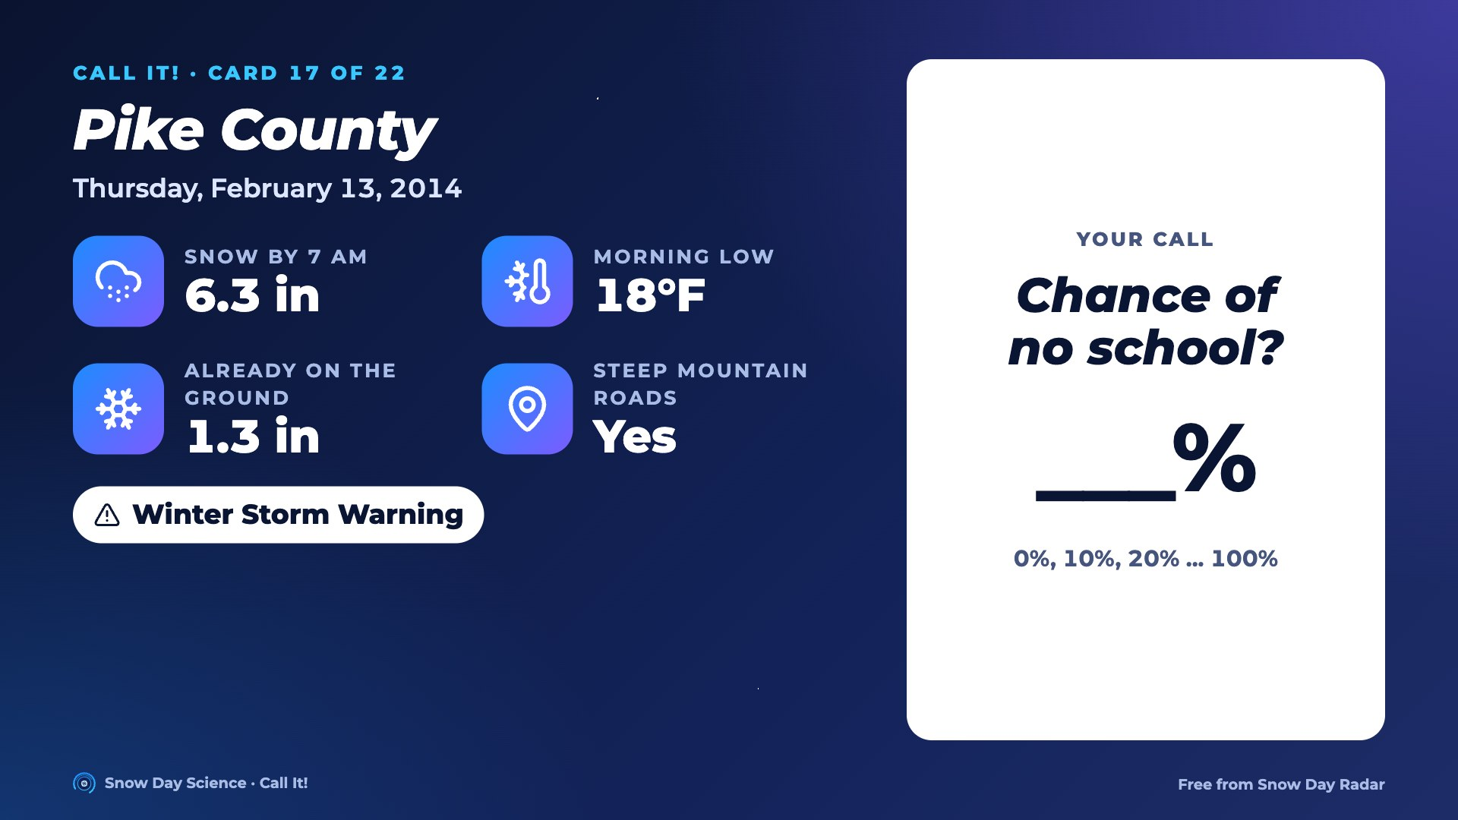
Notes:
Card 17. Read the facts out loud. Everyone writes a chance of no school, 0 to 100%. Then go to the next slide for the answer.

Slide 37
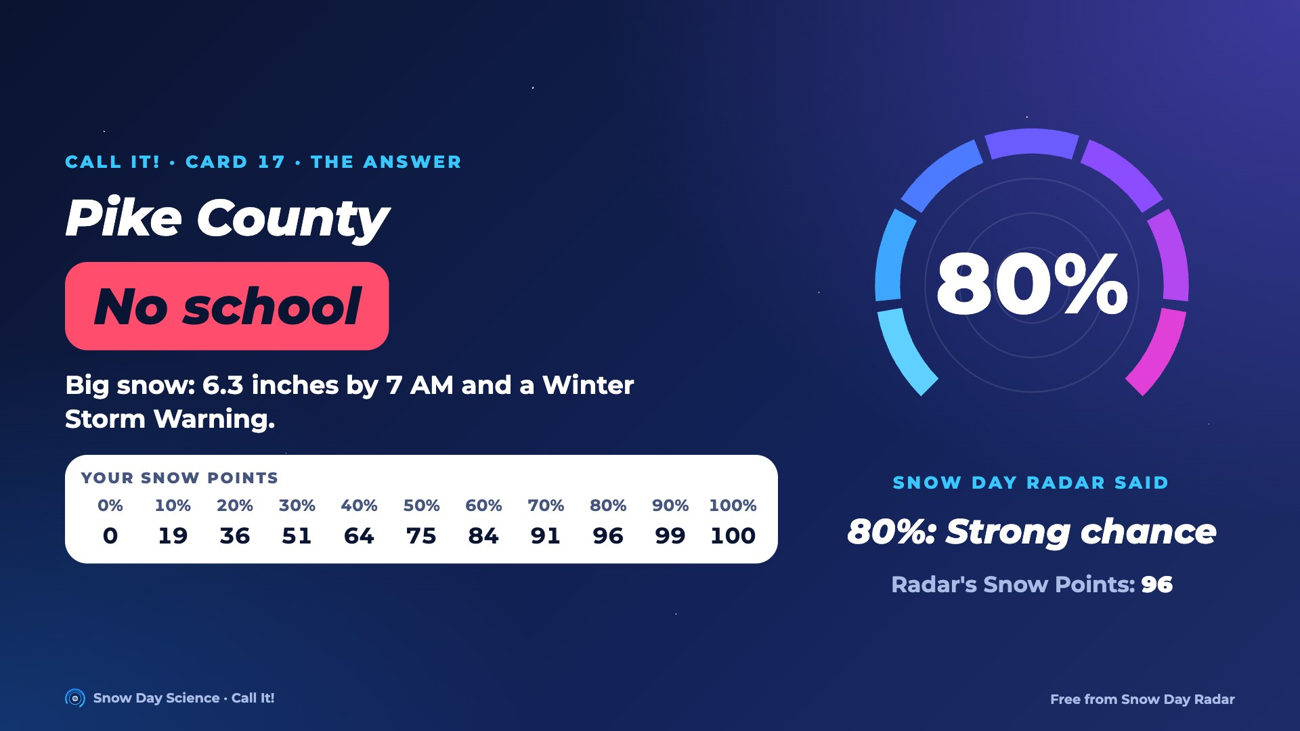
Notes:
Answer for card 17: No school. Snow Day Radar said 80% in a blind test. Big snow: 6.3 inches by 7 AM and a Winter Storm Warning. Students find their Snow Points in the row on screen and compare with the Radar's.

Slide 38
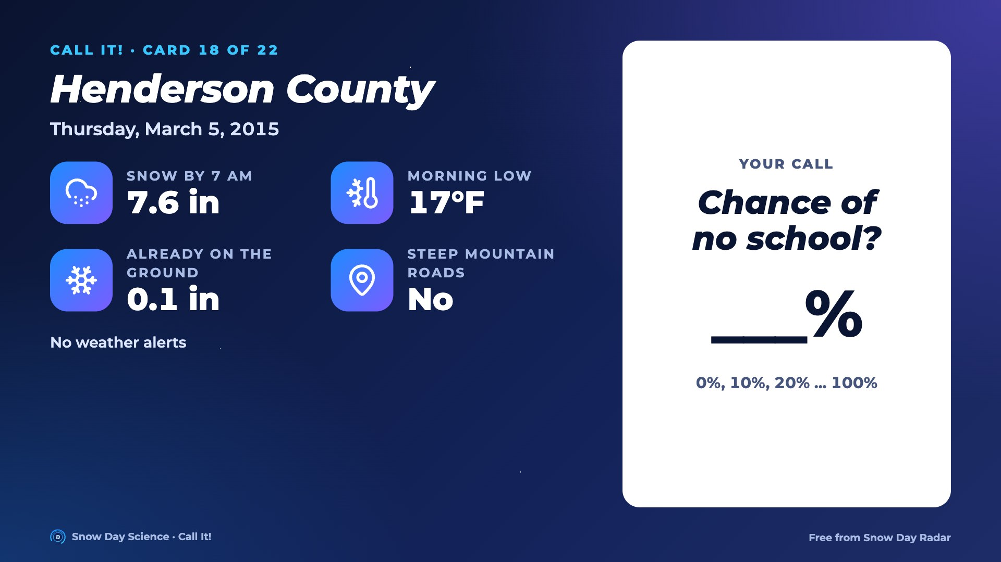
Notes:
Card 18. Read the facts out loud. Everyone writes a chance of no school, 0 to 100%. Then go to the next slide for the answer.

Slide 39
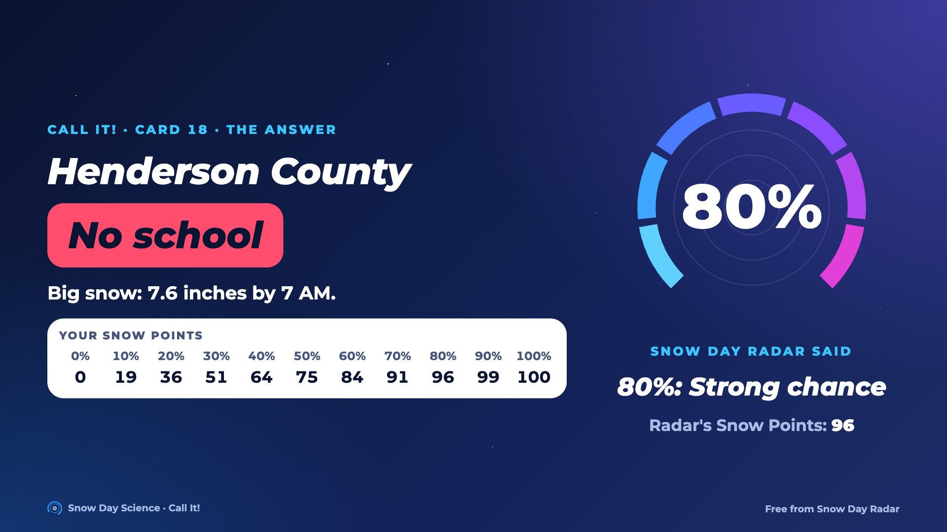
Notes:
Answer for card 18: No school. Snow Day Radar said 80% in a blind test. Big snow: 7.6 inches by 7 AM. Students find their Snow Points in the row on screen and compare with the Radar's.

Slide 40
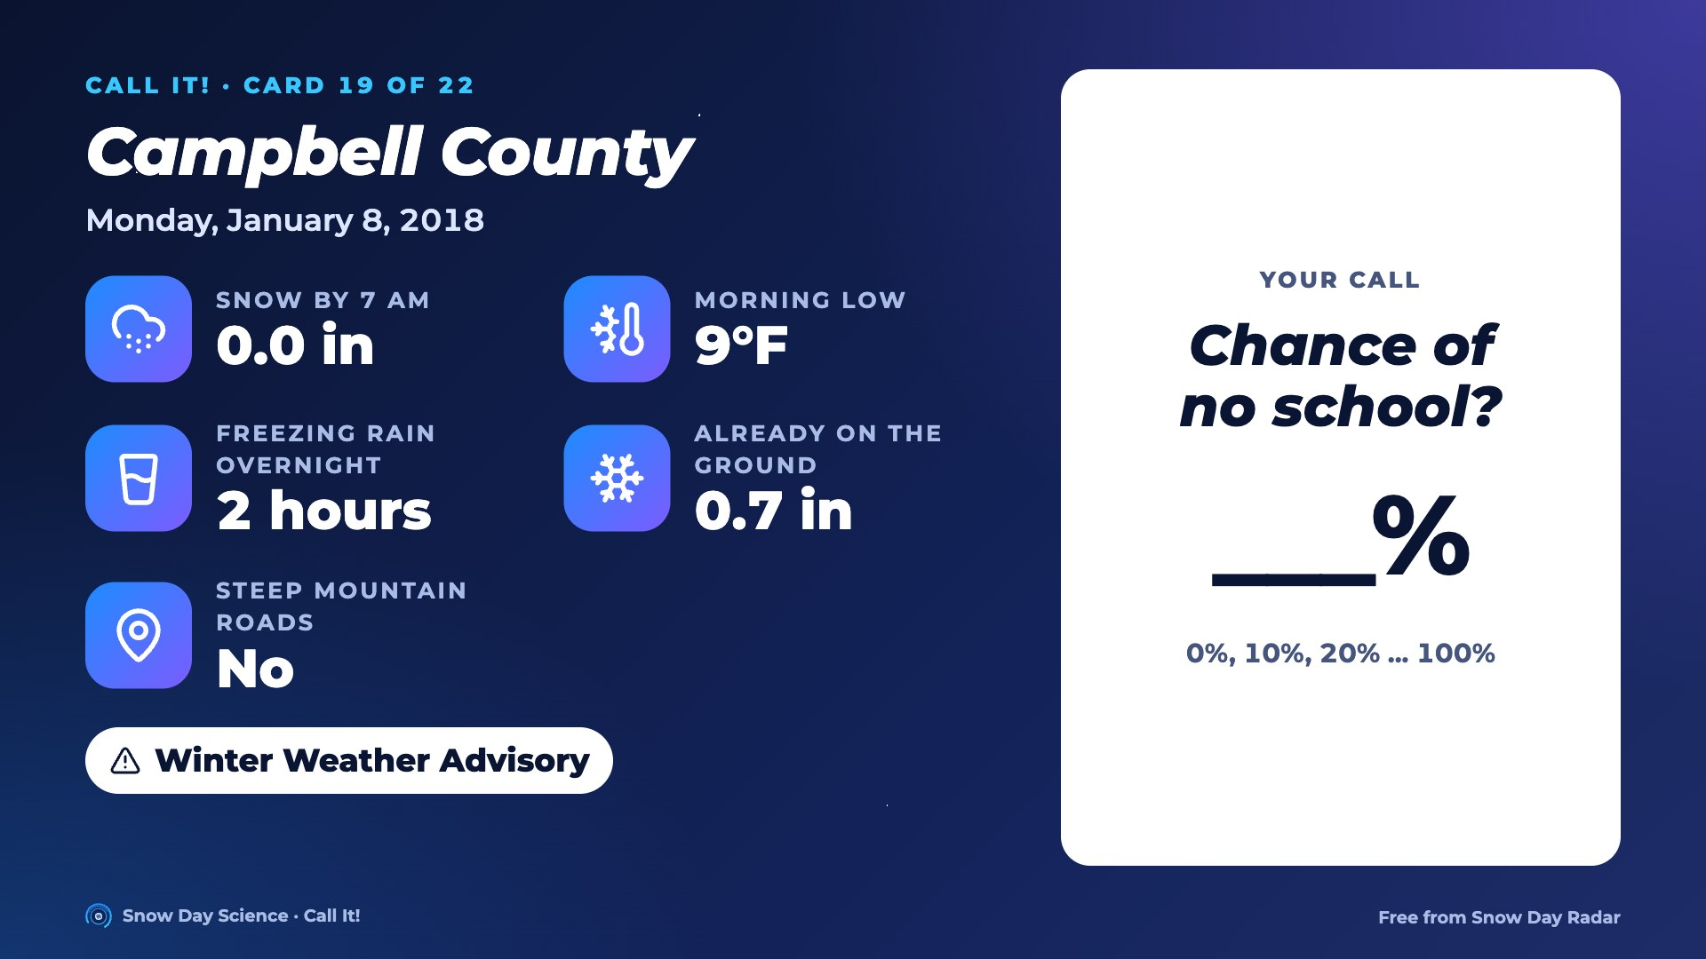
Notes:
Card 19. Read the facts out loud. Everyone writes a chance of no school, 0 to 100%. Then go to the next slide for the answer.

Slide 41
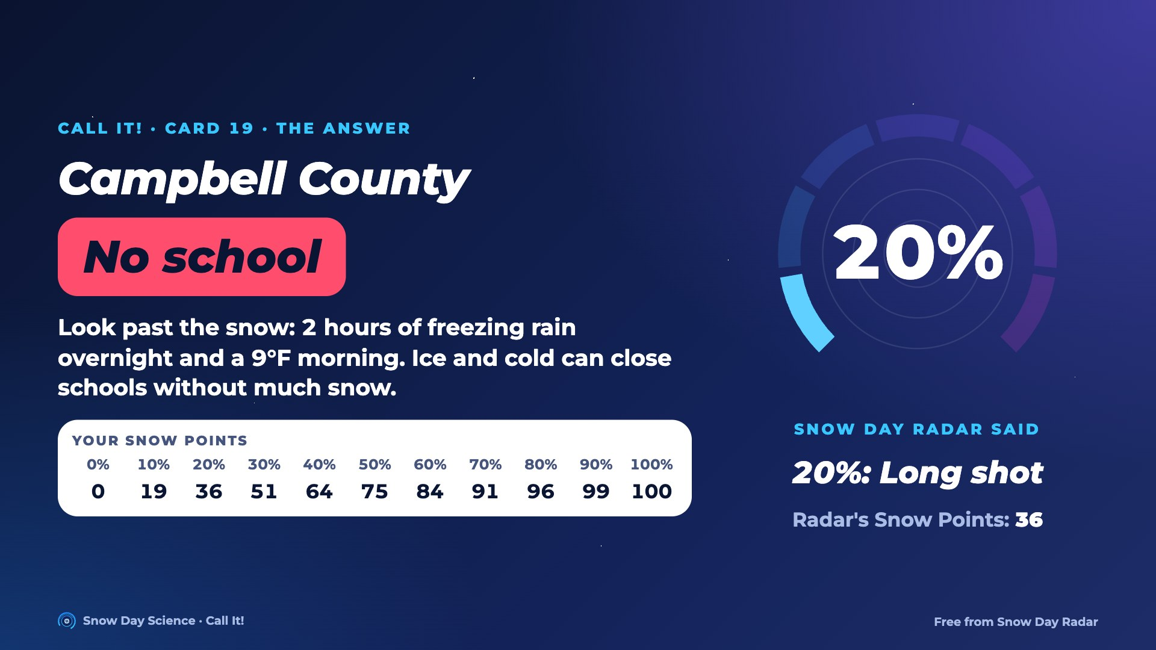
Notes:
Answer for card 19: No school. Snow Day Radar said 20% in a blind test. Look past the snow: 2 hours of freezing rain overnight and a 9°F morning. Ice and cold can close schools without much snow. Students find their Snow Points in the row on screen and compare with the Radar's.

Slide 42
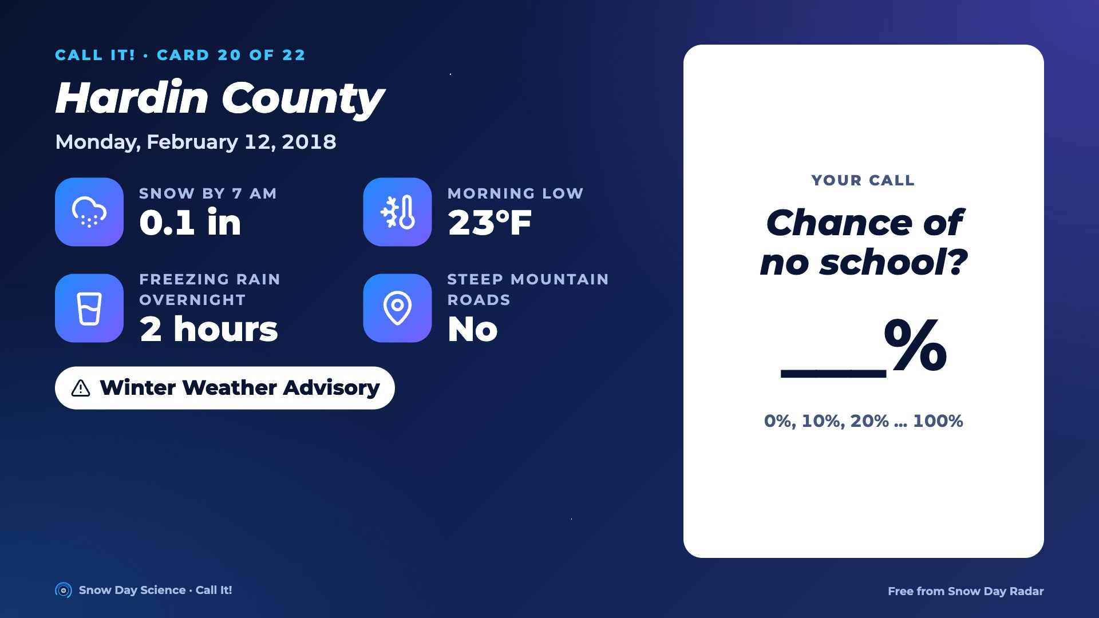
Notes:
Card 20. Read the facts out loud. Everyone writes a chance of no school, 0 to 100%. Then go to the next slide for the answer.

Slide 43
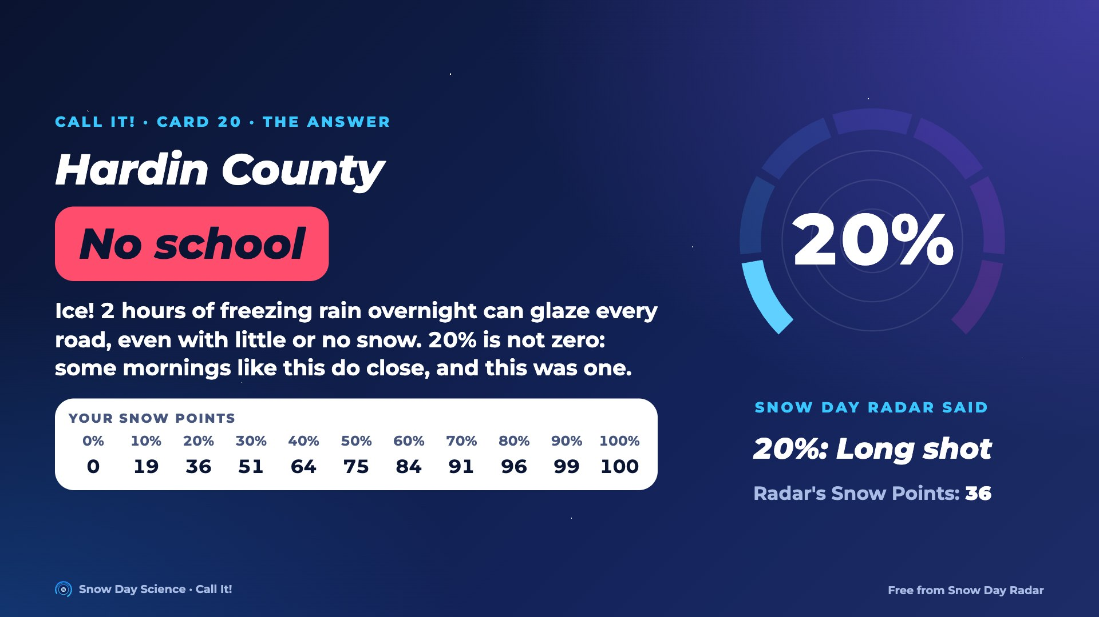
Notes:
Answer for card 20: No school. Snow Day Radar said 20% in a blind test. Ice! 2 hours of freezing rain overnight can glaze every road, even with little or no snow. 20% is not zero: some mornings like this do close, and this was one. Students find their Snow Points in the row on screen and compare with the Radar's.

Slide 44
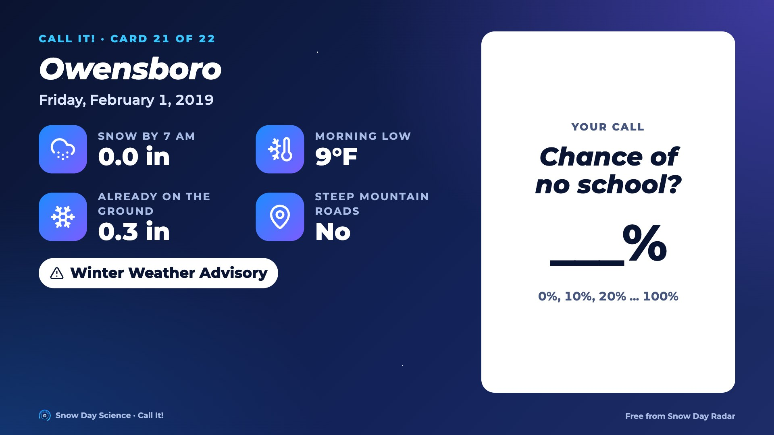
Notes:
Card 21. Read the facts out loud. Everyone writes a chance of no school, 0 to 100%. Then go to the next slide for the answer.

Slide 45
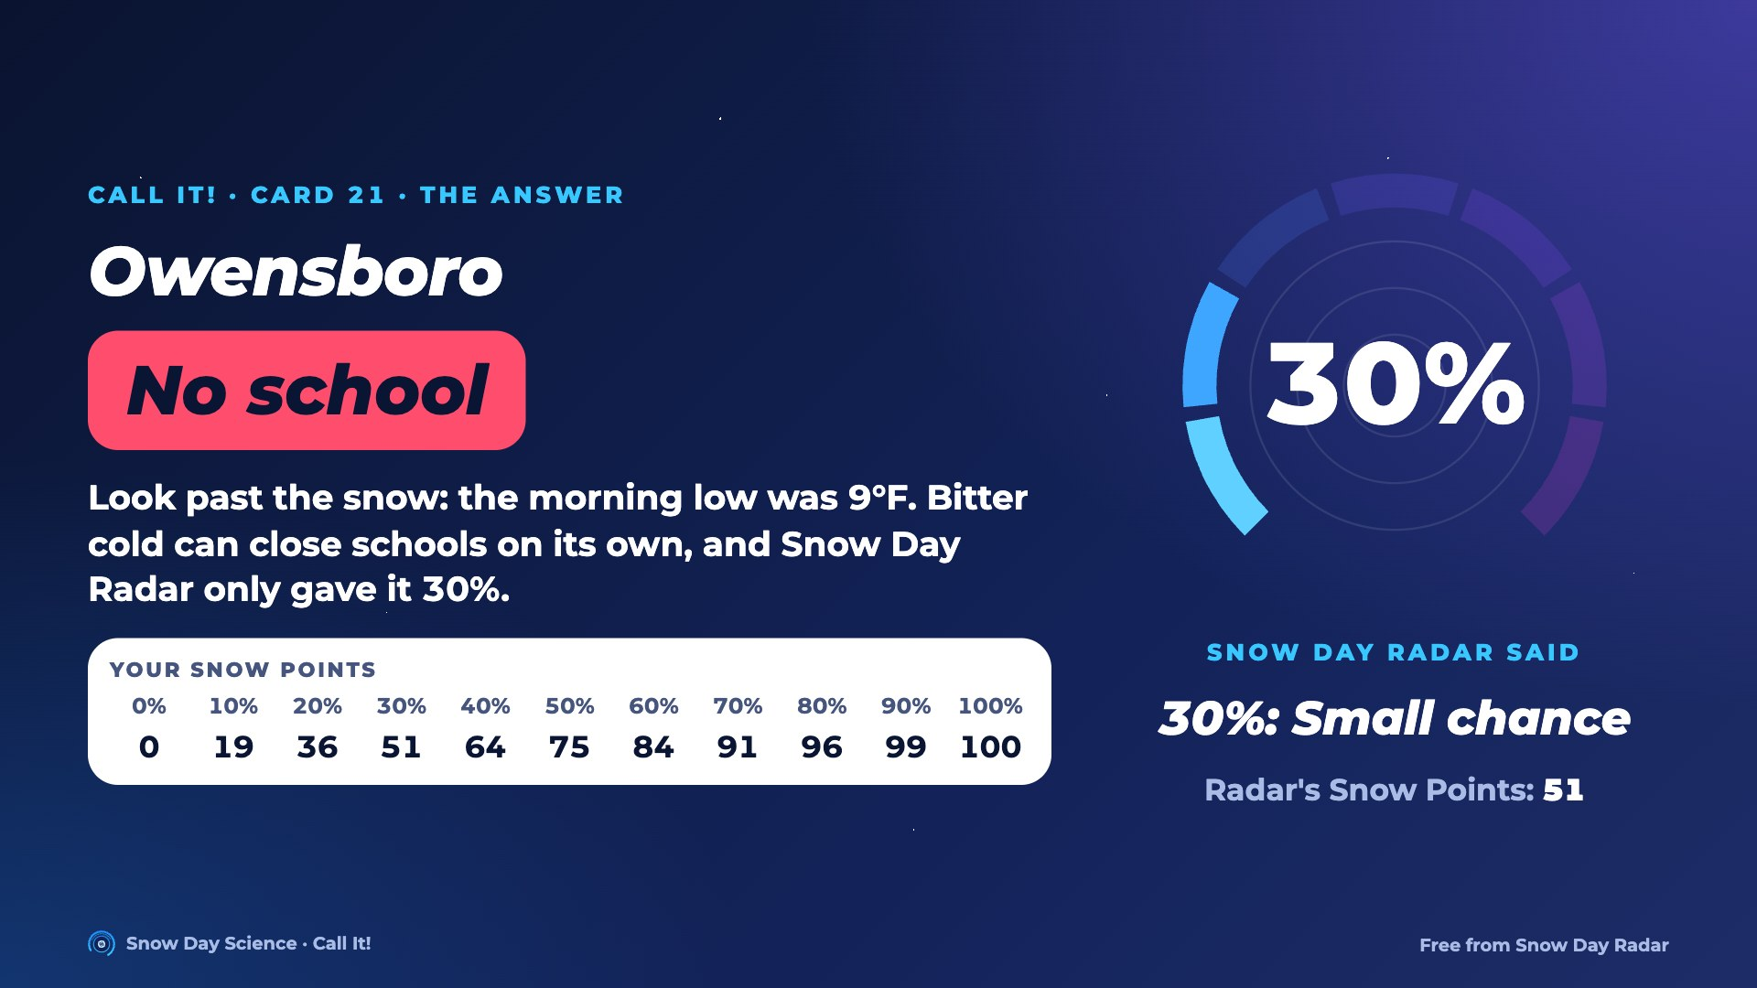
Notes:
Answer for card 21: No school. Snow Day Radar said 30% in a blind test. Look past the snow: the morning low was 9°F. Bitter cold can close schools on its own, and Snow Day Radar only gave it 30%. Students find their Snow Points in the row on screen and compare with the Radar's.

Slide 46

Notes:
Card 22. Read the facts out loud. Everyone writes a chance of no school, 0 to 100%. Then go to the next slide for the answer.

Slide 47
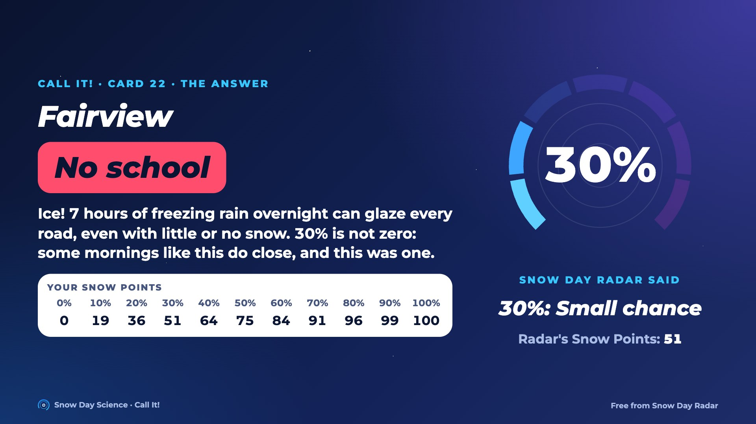
Notes:
Answer for card 22: No school. Snow Day Radar said 30% in a blind test. Ice! 7 hours of freezing rain overnight can glaze every road, even with little or no snow. 30% is not zero: some mornings like this do close, and this was one. Students find their Snow Points in the row on screen and compare with the Radar's.

Slide 48
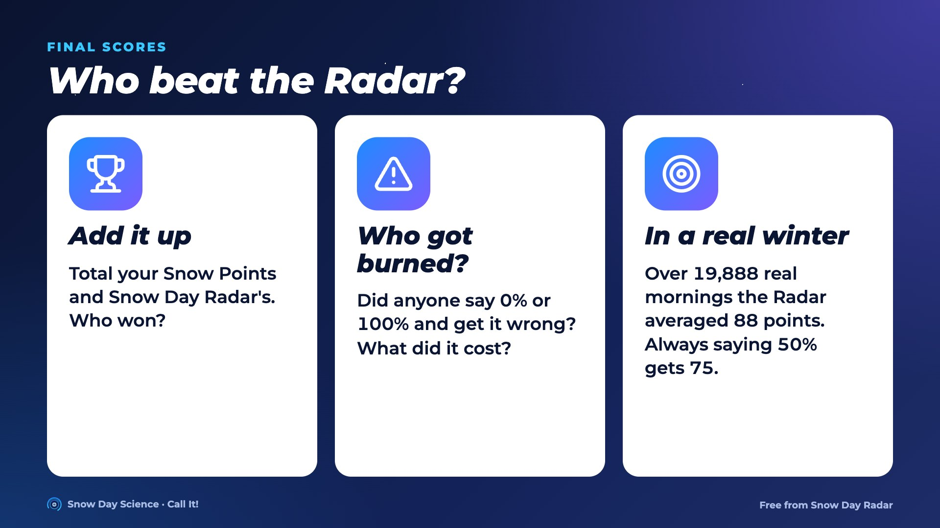
Notes:
Total the game sheets. Ask who beat Snow Day Radar on these cards, and who lost big by saying 0% or 100%. Remind the class these cards were picked to include surprises; over a real winter the Radar averaged 88 Snow Points a morning.

